Slide 1

Lection 10 AC drive converters: PWM algorithms
Asc. Prof. Nikolai Poliakov
Asc. Prof. Sergei Lovlin
Asc. Prof. Dmitry Lukichev

Slide 2
AGENDA
Basic switching methods in AC drive systems. 120-150-180 degree switching methods of PWM Pulse-Width Modulation in inverters of AC electric drive systems Space-vector modulation (SVM)
Consultation (LAB 5 and theory questions (~12:00-12:25)

Slide 3
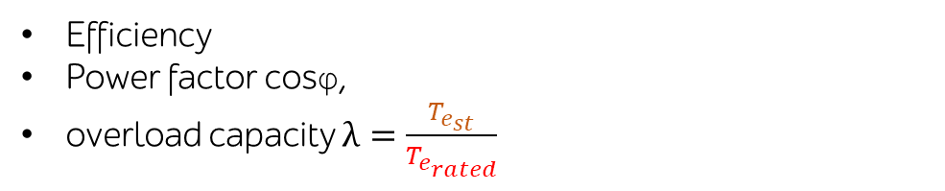
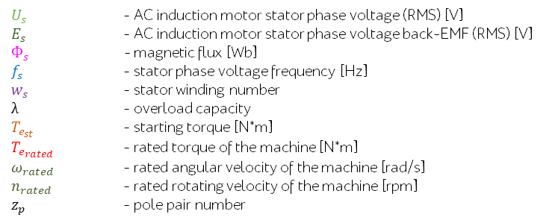
Energy performance of the AC Induction motor
$U_{s}$ - AC induction motor stator phase voltage (RMS) [V]
$E_{s}$ - AC induction motor stator phase voltage back-EMF (RMS) [V]
$Ф_{s}$ - magnetic flux [Wb]
$f_{s}$ - stator phase voltage frequency [Hz]
$w_{s}$ - stator winding number
$λ$ - overload capacity
$T_{e_{st}}$ - starting torque [N*m]
$T_{e_{rated}}$ - rated torque of the machine [N*m]
$ω_{rated}$ - rated angular velocity of the machine [rad/s]
$n_{rated}$ - rated rotating velocity of the machine [rpm]
$z_{p}$ - pole pair number
Efficiency
Power factor cosφ,
overload capacity $λ=\frac{T_{e_{st}}}{T_{e_{rated}}}$
AC induction motor stator voltage
$$U_{s}≈ E_{s}=4,44Ф_{s}f_{s}w_{s}$$
If the voltage drop will be neglected at the active and reactive resistance of the stator winding, then:
$$U_{s}≈ E_{s}=4,44Ф_{s}f_{s}w_{s}≈CФ_{s}f_{s}$$
From these expressions it can be seen that with the constant phase voltage of the power supply${ U}_{s}$, when the frequency $f_{s}$ is regulated, the magnetic flux $Ф_{s}$also changes.

Slide 4
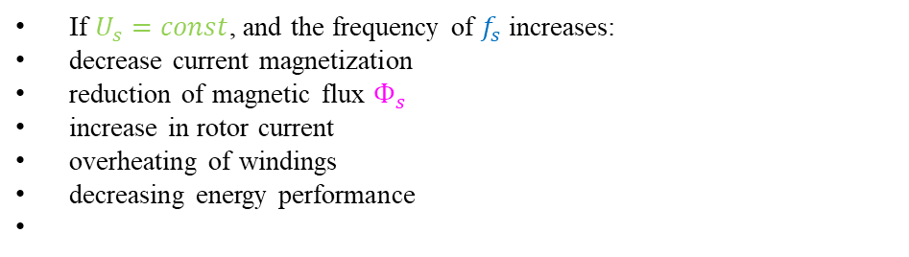
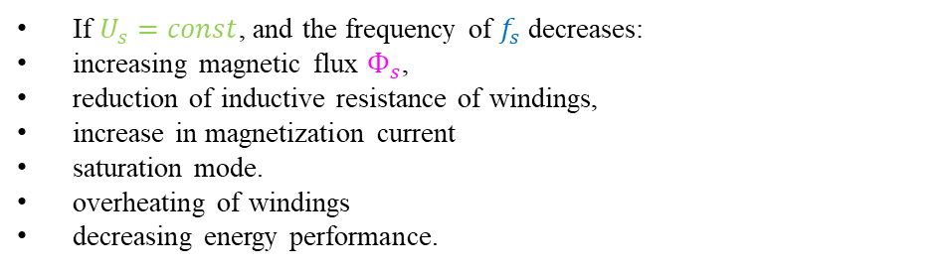
Energy performance of the AC Induction motor
$U_{s}$ - AC induction motor stator phase voltage (RMS) [V]
$E_{s}$ - AC induction motor stator phase voltage back-EMF (RMS) [V]
$Ф_{s}$ - magnetic flux [Wb]
$f_{s}$ - stator phase voltage frequency [Hz]
$w_{s}$ - stator winding number
$λ$ - overload capacity
$T_{e_{st}}$ - starting torque [N*m]
$T_{e_{rated}}$ - rated torque of the machine [N*m]
$ω_{rated}$ - rated angular velocity of the machine [rad/s]
$n_{rated}$ - rated rotating velocity of the machine [rpm]
$z_{p}$ - pole pair number
Efficiency
Power factor cosφ,
overload capacity $λ=\frac{T_{e_{st}}}{T_{e_{rated}}}$
$$U_{s}≈ E_{s}=4,44Ф_{s}f_{s}w_{s}≈CФ_{s}f_{s}$$
From the expression it can be seen that with the constant voltage of the power supply $U_{s}$, when the frequency $f_{s}$is regulated, the magnetic flux $Ф_{s}$ also changes.
If $U_{s}=const$, and the frequency of $f_{s}$decreases: increasing magnetic flux $Ф_{s}$, reduction of inductive resistance of windings, increase in magnetization current saturation mode. overheating of windings decreasing energy performance.
If $U_{s}=const$, and the frequency of $f_{s}$increases: decrease current magnetization reduction of magnetic flux $Ф_{s}$ increase in rotor current overheating of windings decreasing energy performance
For the best use of the AC Induction motor when regulating the rotational speed by changing the frequency $f_{s}$, it is necessary to simultaneously adjust the magnitude of stator phase voltage$U_{s}$.

Slide 5
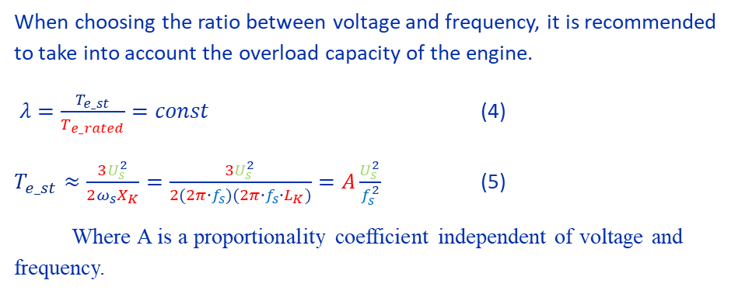
How to change voltage and frequency
When choosing the ratio between voltage and frequency, it is recommended to take into account the overload capacity of the engine. $λ=\frac{T_{e_st}}{T_{e_rated}}=const$ (4)
$T_{e_st}≈\frac{3U_{s}^{2}}{2ω_{s}X_{K}}=\frac{{3U}_{s}^{2}}{2(2π∙f_{s})(2π∙f_{s}∙L_{K})}=A\frac{U_{s}^{2}}{f_{s}^{2}}$ (5)
Where A is a proportionality coefficient independent of voltage and frequency.
$U_{s}$ - AC induction motor stator phase voltage (RMS) [V]
$E_{s}$ - AC induction motor stator phase voltage back-EMF (RMS) [V]
$Ф_{s}$ - magnetic flux [Wb]
$f_{s}$ - stator phase voltage frequency [Hz]
$w_{s}$ - stator winding number
$λ$ - overload capacity
$T_{e_{st}}$ - starting torque [N*m]
$T_{e_{rated}}$ - rated torque of the machine [N*m]
$ω_{rated}$ - rated angular velocity of the machine [rad/s]
$n_{rated}$ - rated rotating velocity of the machine [rpm]
$z_{p}$ - pole pair number

Slide 6
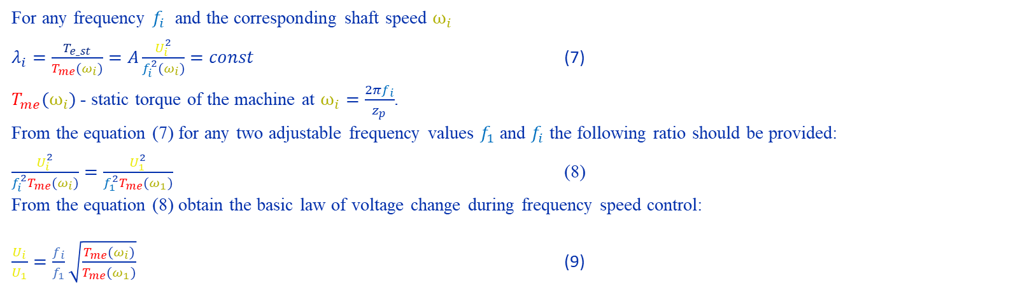
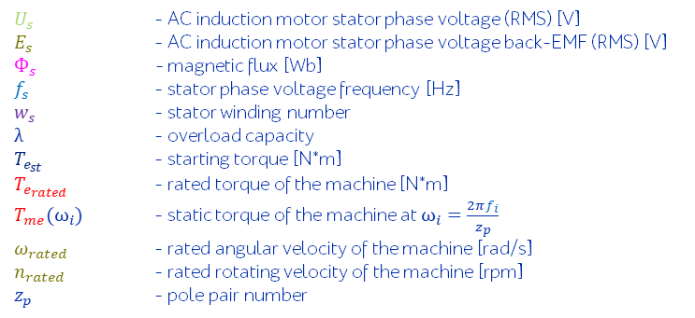
How to change voltage and frequency
When choosing the ratio between voltage and frequency, it is recommended to take into account the overload capacity of the engine. $λ=\frac{T_{e_st}}{T_{e_rated}}=const$ (4)
$T_{e_st}≈\frac{3U_{s}^{2}}{2ω_{s}X_{K}}=\frac{{3U}_{s}^{2}}{2(2π∙f_{s})(2π∙f_{s}∙L_{K})}=A\frac{U_{s}^{2}}{f_{s}^{2}}$ (5)
Where A is a proportionality coefficient independent of voltage and frequency.
$U_{s}$ - AC induction motor stator phase voltage (RMS) [V]
$E_{s}$ - AC induction motor stator phase voltage back-EMF (RMS) [V]
$Ф_{s}$ - magnetic flux [Wb]
$f_{s}$ - stator phase voltage frequency [Hz]
$w_{s}$ - stator winding number
$λ$ - overload capacity
$T_{e_{st}}$ - starting torque [N*m]
$T_{e_{rated}}$ - rated torque of the machine [N*m]
$T_{me}(ω_{i})$ - static torque of the machine at $ω_{i}=\frac{2πf_{i}}{z_{p}}$
$ω_{rated}$ - rated angular velocity of the machine [rad/s]
$n_{rated}$ - rated rotating velocity of the machine [rpm]
$z_{p}$ - pole pair number
For any frequency $f_{i}$ and the corresponding shaft speed $ω_{i}$
$λ_{i}=\frac{T_{e_st}}{T_{me}(ω_{i})}=A\frac{U_{i}^{2}}{f_{i}^{2}(ω_{i})}=const$ (7)
$T_{me}(ω_{i})$- static torque of the machine at $ω_{i}=\frac{2πf_{i}}{z_{p}}$.
From the equation (7) for any two adjustable frequency values $f_{1}$ and $f_{i}$ the following ratio should be provided:
$\frac{U_{i}^{2}}{f_{i}^{2}T_{me}(ω_{i})}=\frac{U_{1}^{2}}{f_{1}^{2}T_{me}(ω_{1})}$ (8)
From the equation (8) obtain the basic law of voltage change during frequency speed control:
$\frac{U_{i}}{U_{1}}=\frac{f_{i}}{f_{1}}\sqrt{\frac{T_{me}(ω_{i})}{T_{me}(ω_{1})}}$ (9)

Slide 7
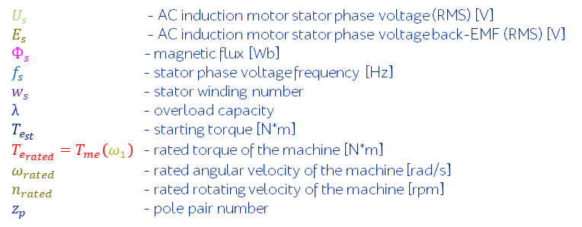
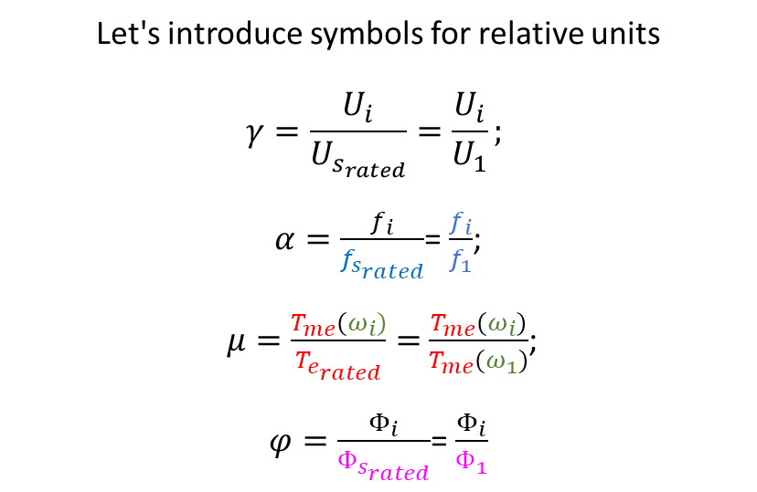
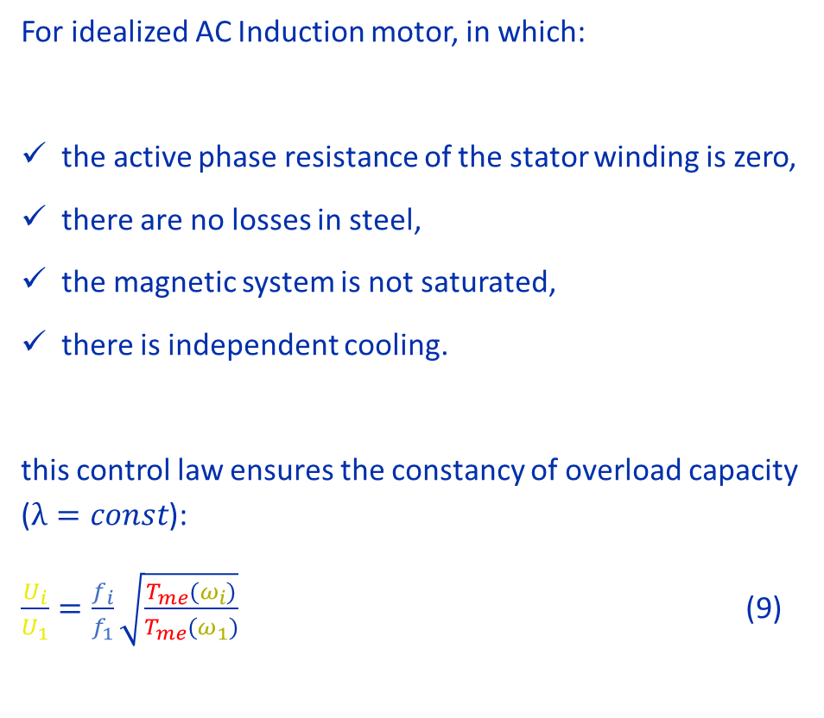
Summary: How to change voltage and frequency
For idealized AC Induction motor, in which:
the active phase resistance of the stator winding is zero, there are no losses in steel, the magnetic system is not saturated, there is independent cooling.
this control law ensures the constancy of overload capacity ($λ=const$): $\frac{U_{i}}{U_{1}}=\frac{f_{i}}{f_{1}}\sqrt{\frac{T_{me}(ω_{i})}{T_{me}(ω_{1})}}$ (9)
$U_{s}$ - AC induction motor stator phase voltage (RMS) [V]
$E_{s}$ - AC induction motor stator phase voltage back-EMF (RMS) [V]
$Ф_{s}$ - magnetic flux [Wb]
$f_{s}$ - stator phase voltage frequency [Hz]
$w_{s}$ - stator winding number
$λ$ - overload capacity
$T_{e_{st}}$ - starting torque [N*m]
$T_{e_{rated}}=T_{me}\left(ω_{1}\right)$ - rated torque of the machine [N*m]
$ω_{rated}$ - rated angular velocity of the machine [rad/s]
$n_{rated}$ - rated rotating velocity of the machine [rpm]
$z_{p}$ - pole pair number
Let's introduce symbols for relative units $γ=\frac{U_{i}}{U_{s_{rated}}}=\frac{U_{i}}{U_{1}};$
$α=\frac{f_{i}}{f_{s_{rated}}}$= $\frac{f_{i}}{f_{1}}$;
$μ=\frac{T_{me}(ω_{i})}{T_{e_{rated}}}=$ $\frac{T_{me}(ω_{i})}{T_{me}(ω_{1})}$;
$φ=\frac{Φ_{i}}{Ф_{s_{rated}}}$= $\frac{Φ_{i}}{Ф_{1}}$

Slide 8
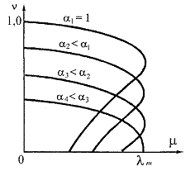
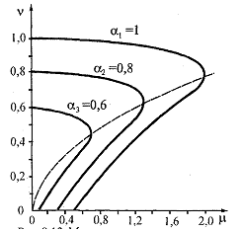
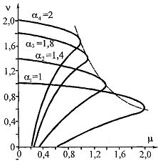
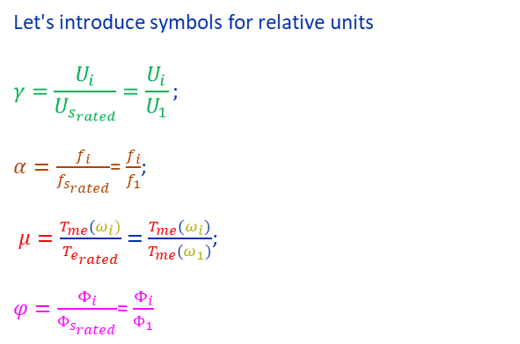
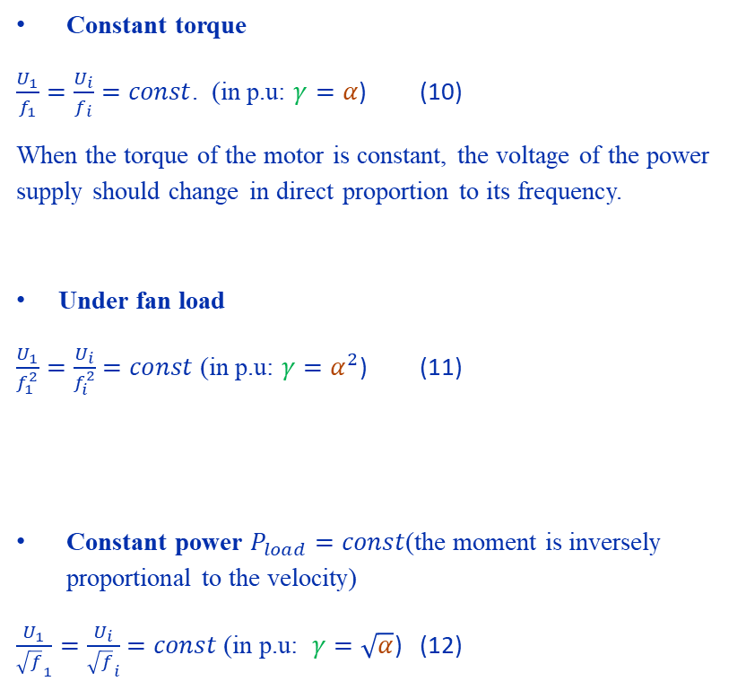
How to change voltage and frequency
Constant torque
$\frac{U_{1}}{f_{1}}=\frac{U_{i}}{f_{i}}=const$. (in p.u: $γ=α$) (10)
When the torque of the motor is constant, the voltage of the power supply should change in direct proportion to its frequency.
Under fan load
$\frac{U_{1}}{f_{1}^{2}}=\frac{U_{i}}{f_{i}^{2}}=const$ (in p.u: $γ=α^{2}$) (11)
Constant power $P_{load}=const$(the moment is inversely proportional to the velocity)
$\frac{U_{1}}{{\sqrt{f}}_{1}}=\frac{U_{i}}{{\sqrt{f}}_{i}}=const$(in p.u: $γ=\sqrt{α}$) (12)
$U_{s}$ - AC induction motor stator phase voltage (RMS) [V]
$E_{s}$ - AC induction motor stator phase voltage back-EMF (RMS) [V]
$Ф_{s}$ - magnetic flux [Wb]
$f_{s}$ - stator phase voltage frequency [Hz]
$w_{s}$ - stator winding number
$λ$ - overload capacity
$T_{e_{st}}$ - starting torque [N*m]
$T_{e_{rated}}$ - rated torque of the machine [N*m]
$ω_{rated}$ - rated angular velocity of the machine [rad/s]
$n_{rated}$ - rated rotating velocity of the machine [rpm]
$z_{p}$ - pole pair number
Let's introduce symbols for relative units
$$γ=\frac{U_{i}}{U_{s_{rated}}}=\frac{U_{i}}{U_{1}};$$
$α=\frac{f_{i}}{f_{s_{rated}}}$= $\frac{f_{i}}{f_{1}}$;
$μ=\frac{T_{me}(ω_{i})}{T_{e_{rated}}}=$ $\frac{T_{me}(ω_{i})}{T_{me}(ω_{1})}$;
$φ=\frac{Φ_{i}}{Ф_{s_{rated}}}$= $\frac{Φ_{i}}{Ф_{1}}$
To implement any frequency control of speed, an inverter must be used,
to allow to adjust the voltage simultaneously with the frequency .
Notes:
Implementing the frequency regulation of the speed of the AC motor, the topology of the power stage and the algorithm of the control system should allow both frequency regulation and simultaneous voltage regulation according to a particular law.
From the expression (9) it can be seen that with the constancy of the torque on the shaft AD at any speed, we get a simple relationship (10) between the adjustable voltage and frequency.
For a fan load at which the torque increases in direct proportion with increasing speed, the ratio between the adjustable voltage and frequency will be given by (11), and
For a load AD operating in a constant power mode, at which the torque is inversely proportional to the velocity, the expression (12).

Slide 9
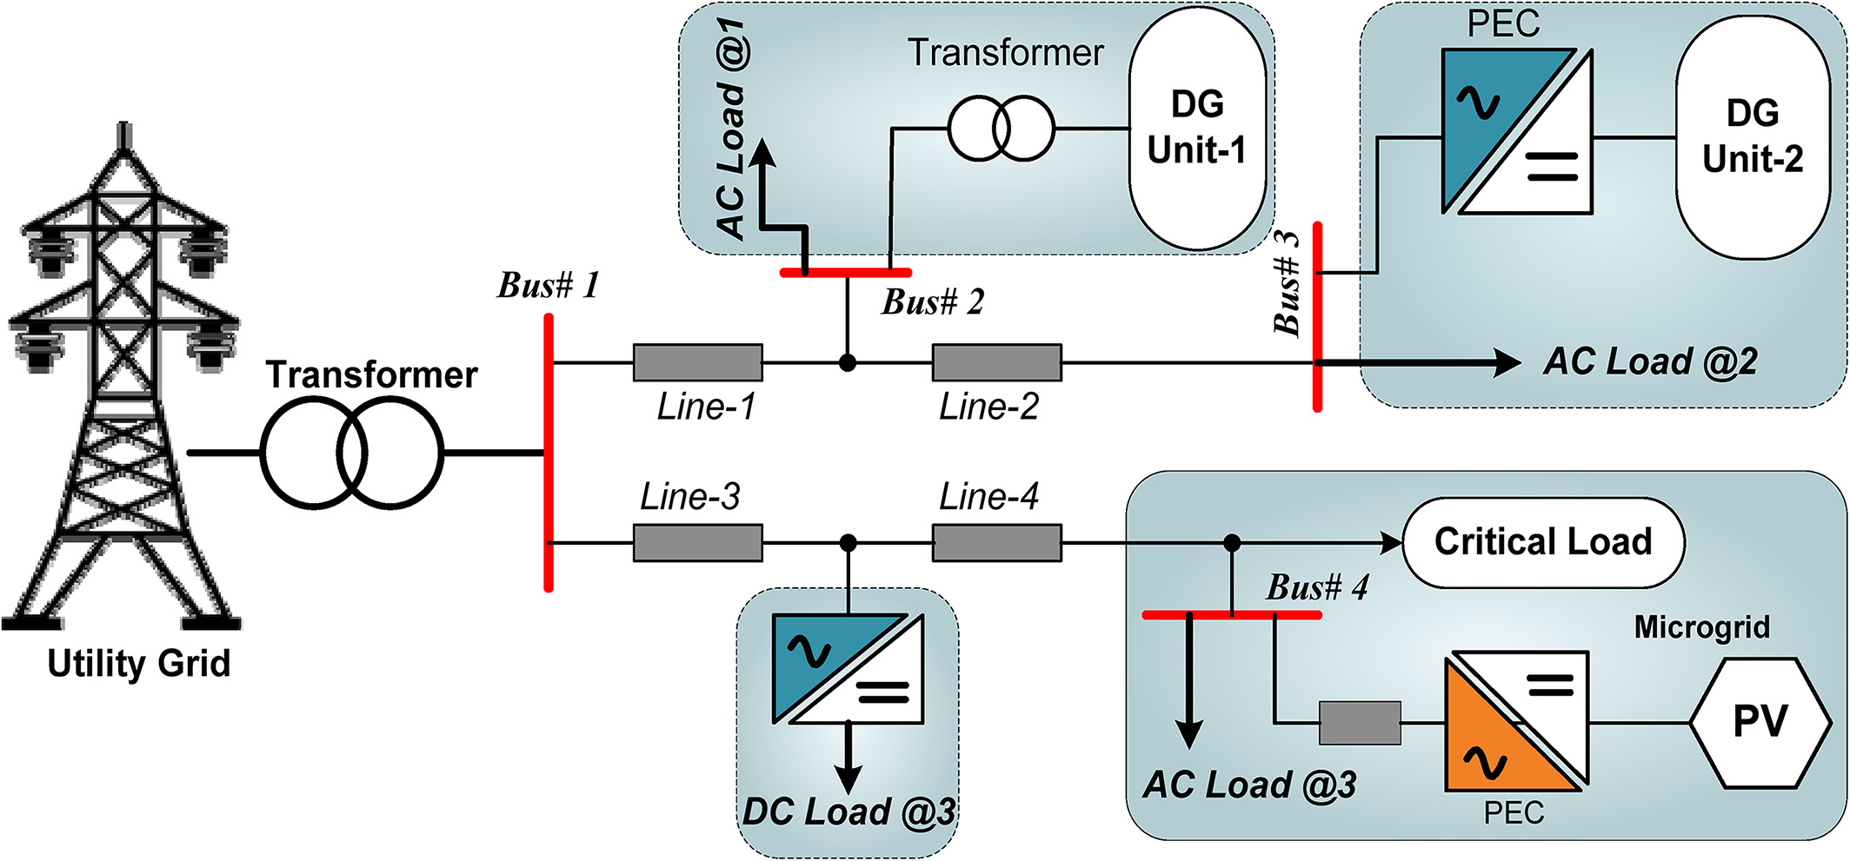
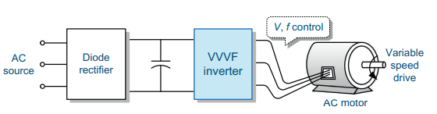
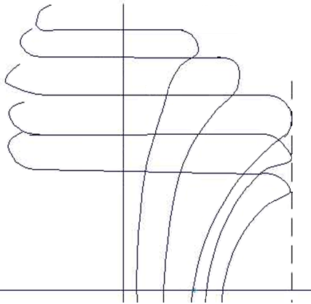



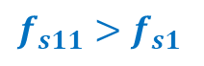


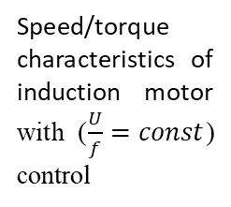
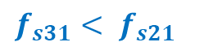


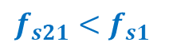
Scheme of switching on the induction motor and its characteristics
(DC Link)
$U_{s}$ - AC induction motor stator phase voltage (RMS) [V]
$E_{s}$ - AC induction motor stator phase voltage back-EMF (RMS) [V]
$Ф_{s}$ - magnetic flux [Wb]
$f_{s}$ - stator phase voltage frequency [Hz]
$w_{s}$ - stator winding number
$λ$ - overload capacity
$T_{e_{st}}$ - starting torque [N*m]
$T_{e_{rated}}$ - rated torque of the machine [N*m]
$ω_{rated}$ - rated angular velocity of the machine [rad/s]
$n_{rated}$ - rated rotating velocity of the machine [rpm]
$z_{p}$ - pole pair number
AC grid
$$ω_{{idle}_{11}}$$
$$f_{s11}>f_{s1}$$
A necessary element of the regulated electric drive is a semiconductor converter (Inverter)
$$ω_{{idle}_{1}}$$
$$f_{s1}$$
$$ω_{{idle}_{21}}$$
$$f_{s21}<f_{s1}$$
$$ω_{{idle}_{31}}$$
$$f_{s31}< f_{s21}$$
Speed/torque characteristics of induction motor with ($\frac{U}{f}=const$) control
$$T_{e_{st}}$$
$$T_{e_{max}}$$
Notes:
One of the possible topologies of the power stage (power unit, power subsystem) is presented on this slide. In this configuration, the power subsystem allows you to regulate the voltage, diode rectifier transform AC grid voltage to DC voltage in DC link with the capacitor filter, and the inverter converts this voltage into a 3-phase voltage of adjustable frequency.

Slide 10
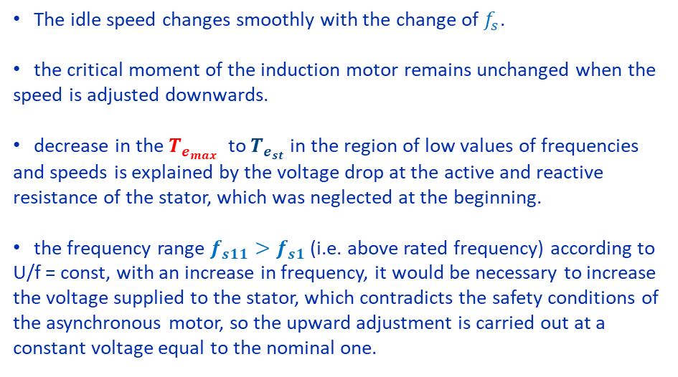
Scheme of switching on the induction motor and its characteristics
$U_{s}$ - AC induction motor stator phase voltage (RMS) [V]
$E_{s}$ - AC induction motor stator phase voltage back-EMF (RMS) [V]
$Ф_{s}$ - magnetic flux [Wb]
$f_{s}$ - stator phase voltage frequency [Hz]
$w_{s}$ - stator winding number
$λ$ - overload capacity
$T_{e_{st}}$ - starting torque [N*m]
$T_{e_{rated}}$ - rated torque of the machine [N*m]
$ω_{rated}$ - rated angular velocity of the machine [rad/s]
$n_{rated}$ - rated rotating velocity of the machine [rpm]
$z_{p}$ - pole pair number
AC grid
$$ω_{{idle}_{11}}$$
$$f_{s11}>f_{s1}$$
The idle speed changes smoothly with the change of $f_{s}$.
the critical moment of the induction motor remains unchanged when the speed is adjusted downwards.
decrease in the $T_{e_{max}}$ to $T_{e_{st}}$in the region of low values of frequencies and speeds is explained by the voltage drop at the active and reactive resistance of the stator, which was neglected at the beginning.
the frequency range $f_{s11}>f_{s1}$ (i.e. above rated frequency) according to U/f = const, with an increase in frequency, it would be necessary to increase the voltage supplied to the stator, which contradicts the safety conditions of the asynchronous motor, so the upward adjustment is carried out at a constant voltage equal to the nominal one.
$$ω_{{idle}_{1}}$$
$$f_{s1}$$
$$ω_{{idle}_{21}}$$
$$f_{s21}<f_{s1}$$
$$ω_{{idle}_{31}}$$
$$f_{s31}< f_{s21}$$
Speed/torque characteristics of induction motor with ($\frac{U}{f}=const$) control
$$T_{e_{st}}$$
$$T_{e_{max}}$$
Notes:
Mechanical characteristics in constant torque adjustment on the BP axis are presented on this slide. Analysis of mechanical characteristics shows.... This type of mechanical characteristics is valid only for previously accepted assumptions:
the active resistance R1 of the stator winding is zero, there are no losses in steel, the magnetic system is not saturated, There is independent cooling.
When taking into account the active resistance of the windings, the value of the critical moment with a decrease in frequency will also decrease. Under the conditions of safe operation, it is not recommended to increase the supply voltage above the nominal one, therefore, upward regulation is carried out at the rated voltage, and therefore the critical moment will decrease with increasing frequency.

Slide 11
Basic switching methods. 120-150-180 degree switching methods of PWM

Slide 12
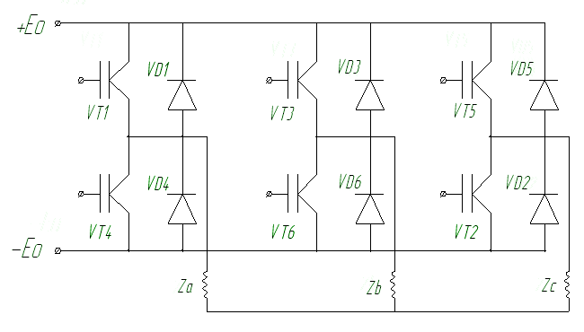
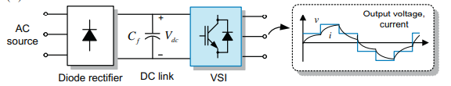
Power converter with DC link
1 type: direct frequency conversion (NDT) (with direct connection of the grid and the load circuit).
2 type: Power converter with DC link
“Leg” or half-bridge
The method of switching transistors of a 3-phase bridge circuit should ensure: 1. Equivalent load for each piece of switching equipment. 2. Constancy or immutability of the structure of the power part of the inverter, i.e. so that the load circuit of the inverter, formed at different intervals of the switching period, does not break and does not significantly change its resistance at the moments of current flow in it. 3. The reversibility of electrical energy flows from the primary power source to the load and vice versa. 4. With any method of switching the transistor keys of the bridge it is necessary to exclude the simultaneous witch-on state of both switches in the half-bridge
Notes:
Consider the principles of operation and electromagnetic processes in the inverter with a direct current link. To obtain a quasi-sinusoidal voltage on the AD windings, various switching laws of the transistor switches of the bridge are possible. As well as in inverters of DC electric drive systems, the law and method of switching transistors of a 3-phase bridge circuit are selected in such a way as to ensure: 1. Uniform loading of the entire set of switching equipment. 2. The constancy or invariance of the structure of the power part of the inverter, i.e. so that the inverter load circuit formed at different intervals of the switching period does not break and does not significantly change its resistance at the moments of current flow in it. 3. Reversibility of electrical energy flows from the primary power source to the load and vice versa. With any law and method of switching transistor switches of a voltage inverter, it is necessary to exclude the possibility of the simultaneous on-state of any two series-connected switches (so called “leg” or half-bridge). The operation of three-phase voltage inverters of electric drive systems is influenced by factors such as the connection diagram of the windings of the AC machine (star or triangle), the method (algorithm) of regulating the output voltage, and the nature of the load.
Рассмотрим принципы работы и электромагнитные процессы в ПЧ со звеном постоянного тока.
Для получения квазисинусоидального напряжения на обмотках АД возможны различные законы коммутации транзисторных ключей моста.
Также, как и в инверторах систем электроприводов постоянного тока, закон и способ коммутации транзисторов 3-х фазной мостовой схемы выбираются таким образом, чтобы обеспечить:
1. Равномерную загрузку всего комплекта коммутирующего оборудования.
2. Постоянство или неизменность структуры силовой части инвертора, т.е. чтобы цепь нагрузки инвертора, образующаяся на различных интервалах периода коммутации не разрывалась и не меняла существенно своего сопротивления в моменты протекания тока в ней.
3. Обратимость потоков электрической энергии, протекающих от первичного источника питания к нагрузке и наоборот.
При любом законе и способе коммутации транзисторных ключей инвертора напряжения необходимо исключить только одновременное включение двух последовательно соединенных ключей.
На работу трехфазных инверторов напряжения систем электропривода влияют такие факторы, как схема соединения обмоток машины переменного тока (звезда или треугольник), способ (алгоритм) регулирования выходного напряжения, характер нагрузки.

Slide 13
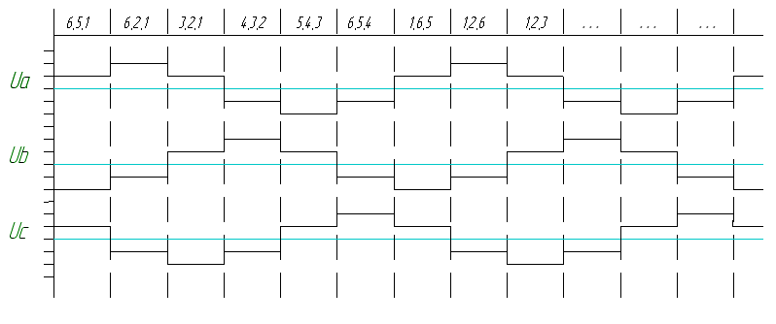
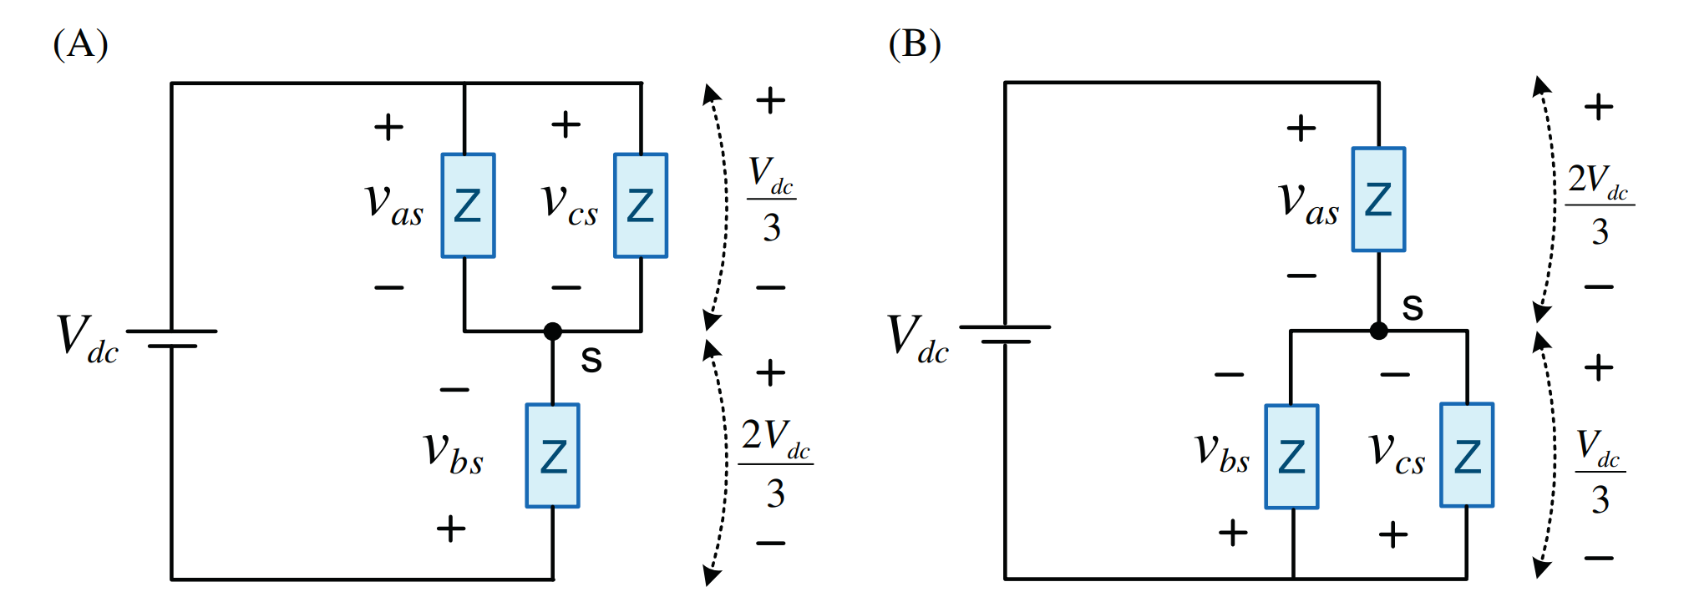
180-degree switching method
During the period of adjustable frequency, six intervals and six different combinations of open and closed bridge transistors can be distinguished.
Notes:
To determine the voltage shape on the phase windings of the stator of an AC machine, let’s consider the circuits for switching on the phases at some of these six intervals (we suppose that windings are Y – Y connected). За время периода регулируемой частоты можно выделить шесть интервалов различных сочетаний открытых и закрытых транзисторов моста. Для определения формы напряжения на обмотках фаз статора машины переменного тока рассмотрим схемы включения фаз на некоторых из этих шести интервалах при их соединении звездой.
For example, let's start the consideration of electromagnetic processes in the system "inverter - AC machine" from the third interval of Fig. ...., when the two upper transistors of the bridge (odd) -VT1 and VT3 and one lower (even) - VT2 are open (i.e., 1,2 and 3 with such numbering of the bridge transistors as in Fig......), with such a combination of including the transistors of the bridge of the beginning of phases A and B through VT1 and VT3 are connected to the positive bus of the DC link, and phase C of the three-phase stator winding through the open VT2 to the negative bus.

Slide 14
180-degree switching method
all transistors of the bridge are fed with control pulses of 180 degrees in a certain sequence, when the shift of the moments of switch on the transistors is 60 degrees. at any given time, three transistors are open at the same time – two upper, one lower or vice versa: two lower and one upper.
in this case, the linear and phase voltages must be shifted between themselves by 120 degrees..
Notes:
There are several options for switching power switches with the topology of the power subsystem which we are considering, but at the same time the linear and phase voltages must be shifted by 120 degrees. The duration of the open state of each of the transistors, as a rule, is half or a third of the period of the adjustable frequency. Возможно несколько вариантов коммутации силовых ключей при рассматриваемой нами топологии энергоподсистемы, но при этом линейные и фазные напряжения должны быть сдвинуты между собой на 120 градусов.
Продолжительность открытого состояния каждого из транзисторов, как правило, составляет половину или треть периода регулируемой частоты.

Slide 15
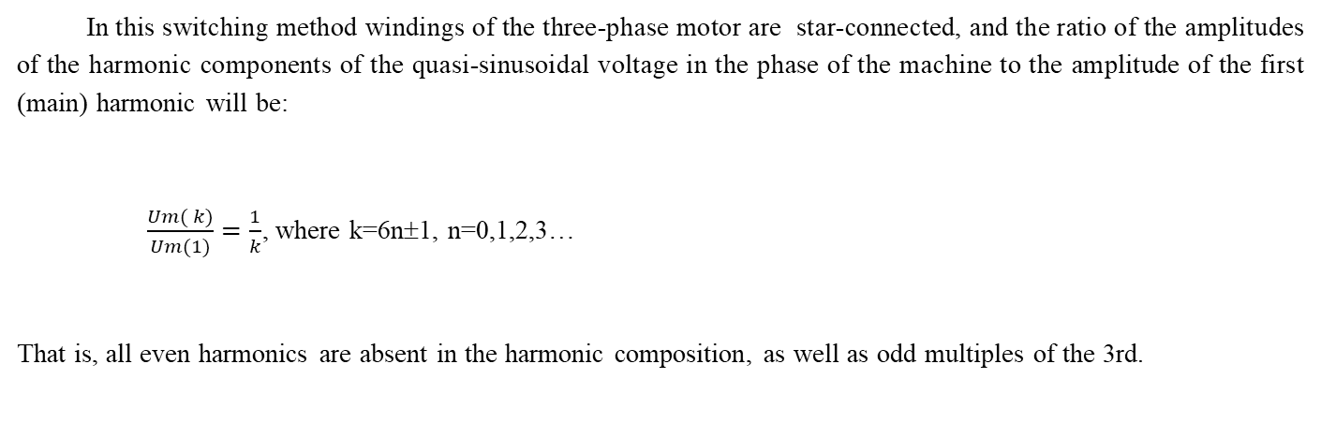
180-degree switching method
За время периода регулируемой частоты можно выделить шесть интервалов различных сочетаний открытых и закрытых транзисторов моста.
In this switching method windings of the three-phase motor are star-connected, and the ratio of the amplitudes of the harmonic components of the quasi-sinusoidal voltage in the phase of the machine to the amplitude of the first (main) harmonic will be:
$\frac{\operatorname{Um}{(}k{)}}{\operatorname{Um}{(}1)}=\frac{1}{k}$, where k=6n±1, n=0,1,2,3…
That is, all even harmonics are absent in the harmonic composition, as well as odd multiples of the 3rd.
Notes:
During the period of adjustable frequency, six intervals of various combinations of open and closed bridge transistors can be distinguished. To determine the voltage shape on the stator phase windings of an AC machine, consider the phase-switching circuits at some of these six intervals when they are connected by a star. If we assume that the resistances of all phases are the same, then the equivalent resistance of parallel phases A and B will be two times less than the resistance of phase C. Consequently, the voltage in these phases A and B will be E0/3, and in phase C twice as much, i.e. 2E₀/3.
At the next (fourth in Fig.....) interval, the upper transistor VT1 is closed and VT4 is connected in series with it, i.e. now the two lower transistors of the bridge are open - VT2 and VT4 and one upper - VT3 (i.e. 2,3 and 4), the phases of the stator windings A and C are connected in parallel to the negative bus of the DC link at 1/3 of its voltage, and the phase B at 2/3 of this voltage, but by its origin through the open VT3 to the positive bus of the DC link.
On the fifth interval (Fig. ......), VT2 is closed, VT5 is connected in series with it, i.e. VT3, VT4 and VT5 are open at the same time - two upper (even) and one lower (3,4 and 5). Phases B and C are connected in parallel and are connected to the positive bus of the DC link, and phase A to the negative bus of the DC link.
Then, on the sixth (Fig......) VT4, VT5 and VT6 are included in the interval, on the first interval VT1, VT5 and VT6 and on the next (second interval of Fig. ....) and the last of our consideration VT1, VT2 and VT6, after which the processes are repeated.
It should be noted that the circuits for connecting the phases of the windings at the intervals of switching on transistors VT1, VT5 and VT6; VT1, VT2 and VT6; VT1, VT2 and VT3 repeat the circuits to include VT2, VT3 and VT4;, VT3, VT4 and VT5; VT4, VT5 and VT6, but with a different voltage polarity at the bases of the phase windings while maintaining the same voltage forms on the phase windings.
The voltage on the phases of the winding has a stepped shape and is variable, and the maxima of these voltages are shifted in phases by a third of the period of the adjustable frequency. Thus, a 3-phase voltage and current system is formed on the AC machine windings, albeit of a non-sinusoidal shape.
За время периода регулируемой частоты можно выделить шесть интервалов различных сочетаний открытых и закрытых транзисторов моста. Для определения формы напряжения на обмотках фаз статора машины переменного тока рассмотрим схемы включения фаз на некоторых из этих шести интервалах при их соединении звездой.
Если принять, что сопротивления всех фаз одинаковы, то эквивалентное сопротивление параллельно соединенных фаз А и В будет в два раза меньше сопротивления фазы С. Следовательно и напряжения на этих фазах А и В будет Е₀/3, а на фазе С в два раза больше, т.е. 2Е₀/3.
На следующем (четвертом на рис…..) интервале закрывается верхний транзистор VT1 и открывается последовательно с ним включенный VT4, т.е. теперь открыты два нижних транзистора моста – VT2 и VT4 и один верхний - VT3 (т.е.2,3 и 4), фазы обмоток статора А и С оказываются подключенными параллельно к минусовой шине звена постоянного тока на 1/3 его напряжения, а фаза В на 2/3 этого напряжения, но своим началом через открытый VT3 к плюсовой шине звена постоянного тока.
На пятом интервале (рис……) закрывается VT2, открывается последовательно с ним включенный VT5, т.е. одновременно открыты VT3, VT4 и VT5 – два верхних (четных) и один нижний (3,4 и 5). Фазы В и С включены параллельно и своими началами подсоединены к плюсовой шине звена постоянного тока, а фаза А к минусовой шине звена постоянного тока.
Затем, на шестом (рис……) интервале включены VT4, VT5 и VT6, на первом интервале VT1, VT5 и VT6 и на следующем (второй интервал рис. ….) и последнем из нашего рассмотрения VT1, VT2 и VT6, после чего процессы повторяются.
Следует отметить, что схемы соединения фаз обмоток на интервалах включения транзисторов VT1, VT5 и VT6;VT1, VT2 и VT6; VT1, VT2 и VT3 повторяют схемы для включения VT2, VT3 и VT4;, VT3, VT4 и VT5; VT4, VT5 и VT6, но с другой полярностью напряжения на началах обмоток фаз при сохранение тех же форм напряжений на обмотках фаз.
Напряжение на фазах обмотки имеет ступенчатую форму и является переменным, причем максимумы этих напряжений сдвинуты по фазам на треть периода регулируемой частоты. Таким образом на обмотках АД образована 3-х фазная система напряжения и тока, хотя и несинусоидальной формы.

Slide 16
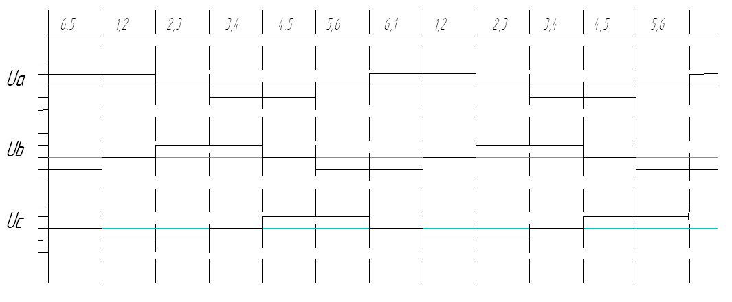
120-degree switching method
the simplest switching method
At any time only two bridge transistors are simultaneously switched on.
at a certain ratio between the active and reactive resistance of the phase, does not allow to ensure the constancy (immutability) of the structure of the power circuit of the converter does not ensure the constancy (immutability) of the current unlike the 180-degree law, there is a 3rd harmonic (with an amplitude of 0.333 from the 1-st), as well as all multiples of the 3-rd.
Notes:
the simplest switching method
At any time only two bridge transistors are simultaneously switched on.
at a certain ratio between the active and reactive resistance of the phase, does not allow to ensure the constancy (immutability) of the structure of the power circuit of the converter does not ensure the constancy (immutability) of the current unlike the 180-degree law, there is a 3rd harmonic (with an amplitude of 0.333 from the 1-st), as well as all multiples of the 3-rd.
наиболее простой закон управления
характеризуется открытым состоянием в любой момент времени только двух транзисторов моста.
при определенном соотношении между активным и реактивным сопротивлении фазы, не обеспечивает постоянства (неизменности) структуры силовой цепи преобразователя
не обеспечивает постоянства (неизменности) тока
В отличии от 180-градусного закона присутствует 3-я гармоника (с амплитудой 0,333 от 1-й), а также все кратные 3-м.

Slide 17
150-degree switching method
the curve of the synthesized sine wave at the principal frequency period will contain seven levels of DC link voltage.
+ 2/3,
+1/2,
+1/3,
0,
- 1/3,
- 1/2,
- 2/3
Notes:
With this control law, the transistor switches are switched in a sequence when the switching intervals of the 2 bridge transistors alternate with the switching intervals of the 3 bridge transistors. Moreover, the duration of switching on each of the transistors of the bridge is 150 degrees.
At the first interval, the transistors VT1 and VT2 are turned on and the phases A and B of the windings of the AC machine, connected according to the "star" scheme, are connected in series to the voltage of the DC link and half of this voltage is applied to each of them. Phase C is disconnected from the DC link.
At the second interval, the transistor VT3 is added to these two, already included transistors VT1 and VT2 in the open state. In this case, the phases A and B of the windings of the AC machine, connected according to the "star" scheme, are connected in parallel and one third of the DC link voltage is applied to them, and the remaining 2/3 of this voltage is applied to phase C.
At the third interval, only the transistor VT1 is turned off, and VT2 and VT3 remain on and half the voltage of the DC link is applied to the phases B and C, and phase A is completely disconnected from the DC link.
At the fourth interval, VT4 is added to the already enabled VT2 and VT3. In this case, the phases A and C of the windings of the AC machine, connected according to the "star" scheme, are connected in parallel and one third of the voltage of the DC link is applied to them, and the remaining 2/3 of this voltage is applied to phase B.
At the fifth interval, the transistor VT2 is turned off, the phase C is disconnected from the power source, and half the voltage of the DC link is applied to the phases A and B through the open transistors VT3 and VT4.
Then VT3, VT4 and VT5 are turned on; then only VT4, VT5; then VT4, VT5 is added to the open VT4, VT6, etc., etc.
Thus, the curve of the synthesized sinusoid on the fundamental frequency period will contain seven levels of DC voltage - 0, + 1/3, +1/2, +2/3, - 1/3, - 1/2, - +2/3.
При данном законе управления транзисторные ключи переключаются в последовательности, когда интервалы включения 2-х транзисторов моста чередуются с интервалами включения 3-х транзисторов моста. Причем длительность включения каждого из транзисторов моста составляет 150 градусов.
На первом интервале включены транзисторы VT1 и VT2 и фазы А и В обмоток машины переменного тока, включенных по схеме «звезда» оказываются включенными последовательно на напряжение звена постоянного тока и к каждой из них прикладывается половина этого напряжения. Фаза С отключена от звена постоянного тока.
На втором интервале к этим двум, уже включенным транзисторам VT1 и VT2 добавляется еще в открытом состоянии транзистор VT3. При этом фазы А и В обмоток машины переменного тока, включенных по схеме «звезда» оказываются включенными параллельно и к ним прикладывается одна треть напряжения звена постоянного тока, а к фазе С, оставшиеся 2/3 этого напряжения.
На третьем интервале отключается только транзистор VT1, а VT2 и VT3 остаются включенными и уже к фазам В и С прикладывается по половине напряжения звена постоянного тока, а фаза А полностью отключается от звена постоянного тока.
На четвертом интервале к уже включенным VT2 и VT3 добавляется VT4. При этом фазы А и С обмоток машины переменного тока, включенных по схеме «звезда» оказываются включенными параллельно и к ним прикладывается одна треть напряжения звена постоянного тока, а к фазе В, оставшиеся 2/3 этого напряжения.
На пятом интервале отключается транзистор VT2, фаза С отключается от источника питания, а к фазам А и В через открытые транзисторы VT3 и VT4 прикладывается по половине напряжения звена постоянного тока.
Затем включены VT3, VT4 и VT5; затем только VT4, VT5; затем к открытым VT4, VT5 добавляется VT6 и т.д. и т.п.
Таким образом кривая синтезированной синусоиды на периоде основной частоты будет содержать семь уровней напряжения звена постоянного тока – 0, + 1/3, +1/2, +2/3, - 1/3, - 1/2, - +2/3.

Slide 18
AC switching method basics
by changing the duration of the transistor, it is possible to smoothly change the frequency up and down from the main one,. The common disadvantage of all these methods is the need to use DC-DC voltage regulator in DC link or active front-end (AFE) instead of diode rectifier to change voltage magnitude.
In addition, this is related with a number of other disadvantages:
unsatisfactory balance of active and reactive power in the AC circuit, which inevitably leads to an increase of total power of the input transformer The presence of higher harmonic components of current and voltage reduces the energy efficiency of the "inverter - AC machine" system. The critical moment and speed are decreasing, losses in copper and steel are increasing
Notes:
In the simplest variants of transistor switching we have considered, non-sinusoidal voltages will be applied to the AC drive windings, which leads to large additional power losses in the windings and their overheating. We have considered the simplest laws of regulation:
by changing the duration of the transistor on, you can smoothly change the frequency up and down from the main one, and the voltage amplitudes are regulated using a hydrocarbon. The common disadvantage of all these methods is the need to use DC-DC voltage regulator in DC link or active front-end (AFE) instead of diode rectifier to change voltage magnitude In addition, this is related with a number of other disadvantages:
unsatisfactory balance of active and reactive power in the AC circuit, which inevitably leads to an increase of total power of the input transformer The presence of higher harmonic components of current and voltage reduces the energy efficiency of the "inverter - AC machine" system. The critical moment and speed are decreasing, losses in copper and steel are increasing
The presence of higher harmonic components of current and voltage reduces the energy and regulation indicators of the "inverter - AC machine" system. The critical moment and speed are reduced, losses in copper and steel increase.
В рассмотренных нами, простейших вариантах коммутации транзисторов, к обмоткам АД будут приложены несинусоидальные напряжения, что приводит к большим дополнительным потерям мощности в обмотках и их перегреву.
Рассмотрены нами простейшие законы регулирования
за счет изменения длительности включения транзистора можно плавно изменять частоту вверх и вниз от основной, а регулирование амплитуд напряжения происходит с помощью УВ.
Общим недостатком всех этих способов является необходимость применения массогабаритного УВ для регулирования величины напряжения на выходе инвертора.
Наличие высших гармонических составляющих тока и напряжения снижает энергетические и регулировочные показатели системы «инвертор – машина переменного тока». Снижаются критический момент и скорость, растут потери в меди и стали.

Slide 19
Pulse Width Control (PWM) in AC inventors

Slide 20
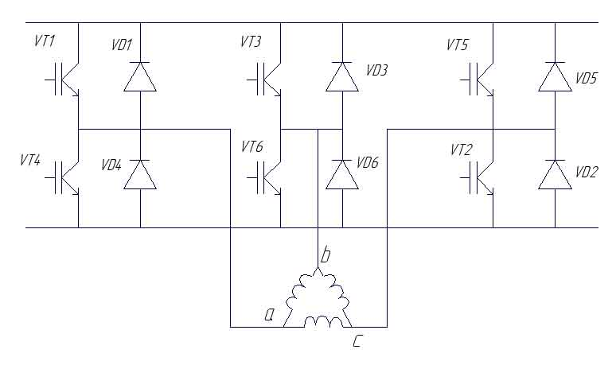
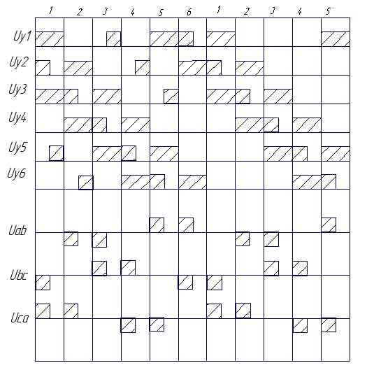
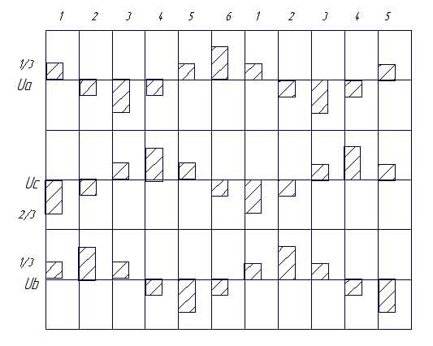
Pulse Width Control at Base Frequency
τ_{SW}
During each period T_{S}, 3 transistors are simultaneously switched-on (two in the anode group and 1 in the cathode group or vice versa).
To disconnect any of the phases from the source and form a pause, 1 transistor should be switched off, which was turned on either in the anode group or the cathode group, and the other two remain.
By adjusting the pulse width and τ_{SW}, the amplitude could be adjusted and
By adjusting T_{S} frequency of the voltage f_{S} on the windings of the AC machine could be adjusted.
T_{S}
Notes:
To improve the harmonic composition of the output voltage of the inverter, the switching frequency of the load circuit is increased by increasing the switching frequency of the transistors. The PWM of the voltage at the output of the AIN at the fundamental frequency is carried out by changing the relative duration of the inclusion of the AD windings in the OST circuit. During each period T_{S} , 3 transistors are simultaneously open (two in the anode group and 1 in the cathode or vice versa). To disconnect any of the phases from the source and form a pause, disconnect 1 transistor, which was turned on either in the anode group or cathode, and the other two remain. Such an algorithm is called a single switching algorithm (SSA). A group switching algorithm (GSA) can be used, when two transistors from the same bridge group are switched off at the same time. SSA, unlike GSA, allows you to maintain constancy in the structure of the power circuit. With AGP, constancy in the structure of the power circuit is preserved only in the motor mode of blood pressure. When switching to generator mode, the immutability of the structure is not preserved. By adjusting the pulse width and t_{Sw}, we adjust the amplitude and frequency of the voltage on the windings of the AC machine.
Для улучшения гармонического состава выходного напряжения инвертора увеличивают частоту коммутации цепи нагрузки за счет увеличения частоты коммутации транзисторов.
ШИР напряжения на выходе АИН на основной частоте осуществляется изменением относительной продолжительности включения обмоток АД в цепь ЗПТ.
В течение каждого периода повторяемости одновременно открыты 3 транзистора (два в анодной группе и 1 в катодной или наоборот). Для отключения любой из фаз от источника и формирования паузы отключаем 1 транзистор, который был включен либо в анодной группе, либо катодной и остаются два других.
Такой алгоритм называется алгоритмом одиночного переключения (АОП).
Могут использоваться алгоритм группового переключения (АГП), когда одновременно выключаются два транзистора из одной и той же группы моста.
АОП в отличии от АГП позволяет сохранять постоянство в структуре силовой цепи. При АГП постоянство в структуре силовой цепи сохраняется только в двигательном режиме работы АД. При переходе в генераторный режим неизменность структуры не сохраняется.
Регулируя ширину импульса и Т_{пвт}, мы регулируем амплитуду и частоту напряжения на обмотках машины переменного тока.

Slide 21
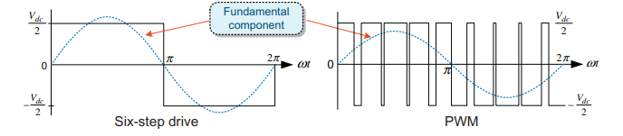

Pulse Width Control at Base Frequency
$U_{s}$ - AC induction motor stator phase voltage (RMS) [V]
$E_{s}$ - AC induction motor stator phase voltage back-EMF (RMS) [V]
$Ф_{s}$ - magnetic flux [Wb]
$f_{s}$ - stator phase voltage frequency [Hz]
$w_{s}$ - stator winding number
$λ$ - overload capacity
$T_{e_{st}}$ - starting torque [N*m]
$T_{e_{rated}}$ - rated torque of the machine [N*m]
$ω_{rated}$ - rated angular velocity of the machine [rad/s]
$n_{rated}$ - rated rotating velocity of the machine [rpm]
$z_{p}$ - pole pair number
During each recurrence period, 3 transistors are simultaneously switched-on (two in the anode group and 1 in the cathode group or vice versa).
To disconnect any of the phases from the source and form a pause, 1 transistor should be switched off, which was turned on either in the anode group or the cathode group, and the other two remain.
By adjusting the pulse width and τ_{SW}, the amplitude could be adjusted and
By adjusting T_{S} frequency of the voltage f_{S} on the windings of the AC machine could be adjusted.
Notes:
By adjusting the pulse width and t_{Sw}, we adjust the amplitude and frequency of the voltage on the windings of the AC machine.

Slide 22
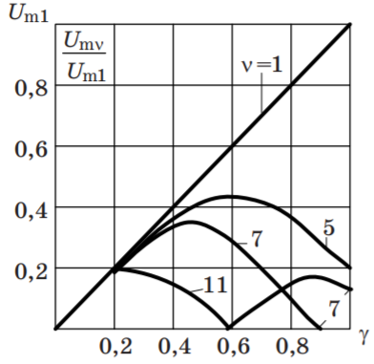
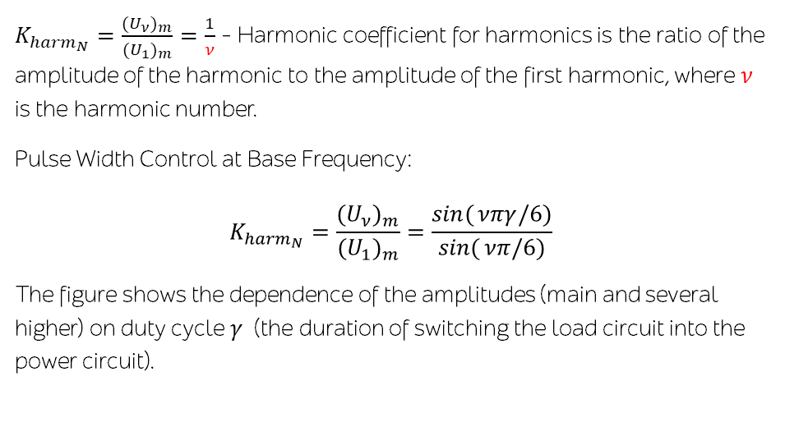
Pulse Width Control at Base Frequency
$K_{{harm}_{N}}=\frac{(U_{ν})_{m}}{(U_{1})_{m}}=\frac{1}{ν}$ - Harmonic coefficient for harmonics is the ratio of the amplitude of the harmonic to the amplitude of the first harmonic, where $ν$ is the harmonic number. Pulse Width Control at Base Frequency:
$$K_{{harm}_{N}}=\frac{(U_{ν})_{m}}{(U_{1})_{m}}=\frac{\sin{(}νπγ/6)}{\sin{(}νπ/6)}$$
The figure shows the dependence of the amplitudes (main and several higher) on duty cycle $γ$ (the duration of switching the load circuit into the power circuit).
Notes:
From this figure it can be seen that when the output voltage decreases, 5,7,11,13 harmonics approach their magnitude to their basic harmonic, which distorts the shape of the current in the machine and leads to pulsation of the moment in the final network and an increase in heat losses.
На рисунке показаны зависимости амплитуд (основной и нескольких высших) от γ (продолжительность включения цепи нагрузки в цепь питания).
Из этого рисунка видно, что при уменьшении выходного напряжения 5,7,11,13 гармоники приближаются по своей величине к своей основной гармонике, что искажает форму тока в машине и приводит в конечном сете к пульсации момента и увеличению потерь в виде тепла.

Slide 23
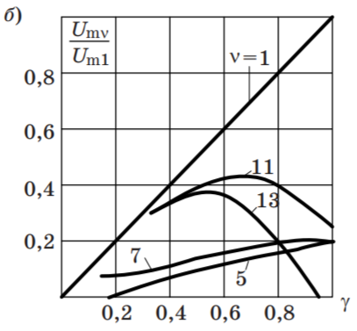
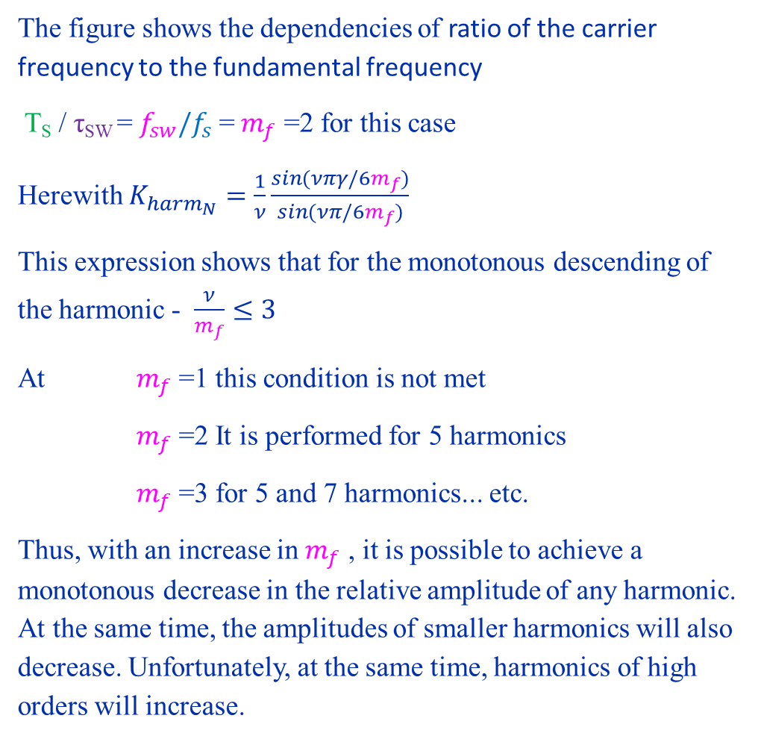
Pulse Width Control at Base Frequency
The figure shows the dependencies of ratio of the carrier frequency to the fundamental frequency T_{S} / τ_{SW} = ${f_{sw}/f}_{s}$= $m_{f}$ =2 for this case
Herewith $K_{{harm}_{N}}=\frac{1}{ν}\frac{\sin{(}νπγ/6m_{f})}{\sin{(}νπ/6m_{f})}$
This expression shows that for the monotonous descending of the harmonic - $\frac{ν}{m_{f}}≤3$
At $m_{f}$ =1 this condition is not met
$m_{f}$ =2 It is performed for 5 harmonics
$m_{f}$ =3 for 5 and 7 harmonics... etc. Thus, with an increase in $m_{f}$ , it is possible to achieve a monotonous decrease in the relative amplitude of any harmonic. At the same time, the amplitudes of smaller harmonics will also decrease. Unfortunately, at the same time, harmonics of high orders will increase.

Slide 24
Pulse-Width Modulation in inverters of AC electric drive systems

Slide 25
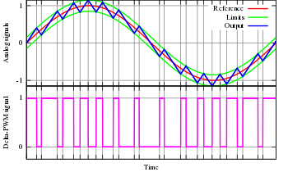
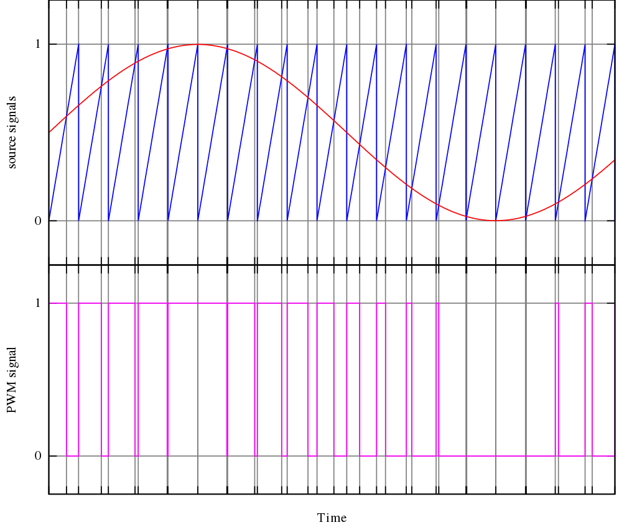
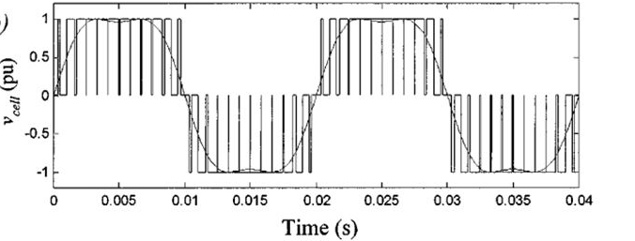
Basic methods of sinusoidal voltage modulation
hysteresis or delta modulation;
analog (scalar) Sine PWM and its modifications; selective suppression of higher harmonics; space vector modulation (SVM / SVPWM).
Delta modulation
Sine PWM
Output voltage with the addition of a sinusoidal third harmonic
Notes:
Hysteresis or delta modulation is based on the principles of relay "tracking" of a reference signal, for example, a sinusoidal shape. The method of selective suppression of higher harmonics in the output voltage of the inverter can be successfully implemented only by means of computer (microprocessor) technology. Currently, it is used in high-power AC electric drives with relatively low switching frequencies. The method of a space vector modulation is based on the transformation of a 3-phase system (in the general case, multiphase) into a 2-phase system and obtaining a generalized space vector. The magnitude of this vector is calculated at times determined by the fundamental and modulating frequencies. The method is in many ways similar to analog (scalar) sinusoidal PWM. A very common and promising method in the presence of a microprocessor in the control system.
All of the above methods for reproducing the sinusoidal output voltage of inverters of AC electric drive systems must provide
a sinusoidal shape of the fundamental harmonic of voltage or current
control the magnitude of its amplitude, frequency and phase. Provide 2-way energy exchange in power stage between the primary AC grid and the load, provided that fully controlled transistor switches.
Naturally, with an increase in the switching frequency of the load circuit, the possibilities of reproducing current and voltage of any given shape at the output of inverters expand.
General Provisions. Pulse width modulation (PWM) of voltages in inverters of AC electric drive systems has a slightly different definition in power electronics than in DC electric drives. This definition should take into account the peculiarities of PWM in the conversion of electrical energy on alternating current. According to IEC-551-16-30, so called PWM is pulse control, in which the width or frequency of the pulses, or both, are modulated within the fundamental frequency period in order to create a certain shape of the output voltage curve on the load. In AC electric drive systems, PWM is carried out in order to ensure the sinusoidal voltage or current on the windings of the AC machine, i.e. reducing the level of higher harmonics relative to the main (first), and this PWM is called sinusoidal.
Гистерезисная или дельта-модуляция основана на принципах релейного «слежения» за опорным сигналом, например синусоидальной формы.
Метод избирательного подавления высших гармоник в выходном напряжении инвертора может успешно реализовываться только средствами вычислительной (микропроцессорной) техники. В настоящее время находит применение в мощных электроприводах переменного тока с относительно низкими частотами коммутации.
Метод модуляции пространственного вектора основан на преобразовании 3-х фазной системы (в общем случае – многофазной) в 2-х фазную и получении обобщенного пространственного вектора. Величина этого вектора рассчитывается в моменты времени, определяемые основной и модулирующей частотами. Метод во многом сходен с аналоговой (скалярной) синусоидальной ШИМ. Очень распространенный и перспективный метод при наличии микропроцессора в системе управления.
Все перечисленные методы воспроизведения синусоидального выходного напряжения инверторов систем электропривода переменного тока должны
обеспечивать синусоидальную форму основной гармоники напряжения или тока
управлять величинами ее амплитуды, частоты и фазы.
реализовывать преобразователи с 2-х сторонним обменом энергии между первичной сетью переменного тока и нагрузкой, при условии использования полностью управляемых транзисторных ключей.
Естественно, что с увеличением частоты коммутации цепи нагрузки расширяются возможности воспроизведения на выходе инверторов тока и напряжения любой заданной формы.
Общие положения.
Широтно – импульсная модуляция (ШИМ) напряжений в инверторах систем электропривода переменного тока имеет в силовой электроники несколько другое определение, чем в электроприводах постоянного тока.
Это определение должно учитывать особенности ШИМ при преобразовании электрической энергии на переменном токе.
Согласно МЭК-551-16-30, ШИМ называется импульсное управление, при котором ширина или частота импульсов или и та, и другая модулируются в пределах периода основной частоты для того, чтобы создать определенную форму кривой выходного напряжения на нагрузке.
В системах электропривода переменного тока ШИМ осуществляется в целях обеспечения синусоидальности напряжения или тока на обмотках машины переменного тока, т.е. снижения уровня высших гармоник относительно основной (первой), и называется синусоидальной.

Slide 26
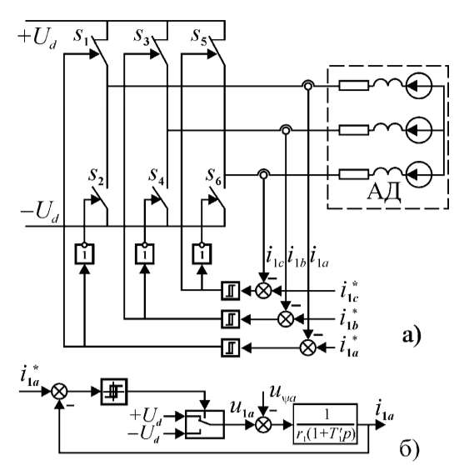
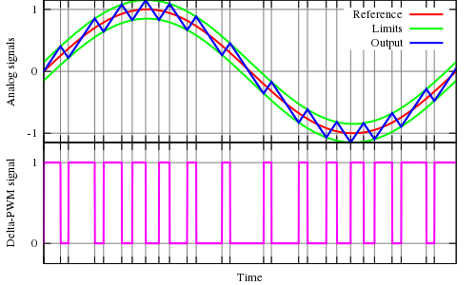
Hysteresis or delta modulation
The method can be reduced to "tracking" the current in the region of permissible deviations from the current value of the set or reference signal.
Each of the three (according to the number of phases of the inverter) regulators has a hysteresis characteristic.
Reference signals are sinusoidal signals for setting phase currents with which
Notes:
В результате на входах гистерезисных регуляторов тока действуют сигналы рассогласования, равные разности сигналов задания и реальных токов фаз двигателя.
Гистерезисный регулятор имеет два устойчивых состояния, каждому из которых соответствует определенный сигнал управления транзисторами любой из трех стоек моста. Например, если на выходе регулятора фазы «А» устанавливается 1, то транзистор S₁ открыт, а S₂ закрыт. И наоборот, если на выходе гистерезисного регулятора устанавливается 0.
Если транзистор S₁ открыт, а S₂ закрыт, то ток в фазе А нарастает при положительной полуволне задающего тока. В момент времени, когда истинный ток фазы А достигает верхней границы токового коридора, рабочая точка регулятора мгновенно перемещается по петле гистерезиса и на его выходе устанавливается 0, транзистор S₁ закрывается, а транзистор S₂ открывается с некоторой задержкой (мертвое время), подключая обмотку фазы А к отрицательной шине источника питания, тем самым обеспечивая изменение направления тока в этой фазе. При достижении истинного тока фазы верхней границы токового коридора процессы повторяются. Таким образом
истинный ток фазы А следует за током задания с максимальным рассогласованием, пропорциональным ширине петли гистерезисного регулятора.
Такой способ регулирования токов в фазах машины переменного тока имеет ряд недостатков:
переменная частоты коммутации транзисторов инвертора, которая зависит от скорости изменения управляющего синусоидального сигнала и на участках, близких к его переходу через ноль она становится выше.
- все три контура регулирования токов фаз работают независимо друг от друга, в то время как процесс коммутации отдельно в каждой обмотке естественно оказывает влияние на электромагнитные процессы в других обмотках. Известно, что в трехфазной системе при соединении обмоток в звезду, в любой момент времени сумма токов всех фаз равна нулю, т.е. независимыми величинами являются только два любых тока, третий ток является их функцией. В результате чего получается, что в рассматриваемой нами системе действуют три независимых регулятора при только двух независимых переменных, что может привести к возникновению сбоя в режиме работы инвертора и выходу ошибки регулирования за границы токового коридора, определяемого наперед заданной шириной петли гистерезиса, которая задается в качестве независимой переменной регулятора.
Возможна реализация другого способа определения моментов переключения транзисторов моста, в котором в качестве независимой переменной регулятора задается тактовая частота переключения. Суть этого способа заключается в том, что переключение ключей производится в моменты времени, определяемые заранее выбранной и постоянной частотой, при условии, что произошло изменение сигнала ошибки на предыдущем периоде следования тактовых импульсов хотя бы в одной из фаз.
Алгоритм переключения может быть следующим:
- Для фазы А: если в момент прихода тактового импульса, следующего с постоянной частотой, ток в фазе при положительной полуволне больше тока задания на заранее заданную величину, то включаем транзистор S2 в нижней группе и два транзистора верхней группы S3 и S5. Если же ток выходит за рамки токового коридора снизу, включаем транзистор S1 верхней группы и два транзистора нижней группы S4 и S6;
Для фаз В и С: аналогично.
Если в момент прихода тактового импульса токи в фазах А,В,С не выходят за пределы своих коридоров, то открываем либо все транзисторы верхней группы, либо все транзисторы нижней группы.
Дальнейшее развитие алгоритмов управления связано с использованием методов нечетной логики, нейросетей.

Slide 27
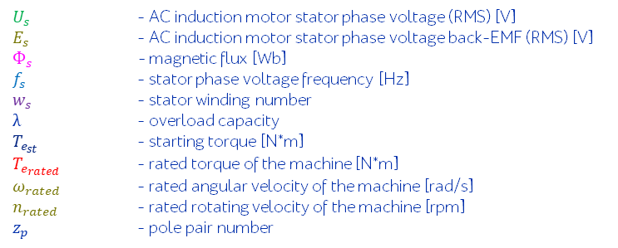
Pulse Width Control at Base Frequency
$U_{s}$ - AC induction motor stator phase voltage (RMS) [V]
$E_{s}$ - AC induction motor stator phase voltage back-EMF (RMS) [V]
$Ф_{s}$ - magnetic flux [Wb]
$f_{s}$ - stator phase voltage frequency [Hz]
$w_{s}$ - stator winding number
$λ$ - overload capacity
$T_{e_{st}}$ - starting torque [N*m]
$T_{e_{rated}}$ - rated torque of the machine [N*m]
$ω_{rated}$ - rated angular velocity of the machine [rad/s]
$n_{rated}$ - rated rotating velocity of the machine [rpm]
$z_{p}$ - pole pair number
During each recurrence period, 3 transistors are simultaneously switched-on (two in the anode group and 1 in the cathode group or vice versa).
To disconnect any of the phases from the source and form a pause, 1 transistor should be switched off, which was turned on either in the anode group or the cathode group, and the other two remain.
By adjusting the pulse width and τ_{SW}, the amplitude could be adjusted and
By adjusting T_{S} frequency of the voltage f_{S} on the windings of the AC machine could be adjusted.
Notes:
Для улучшения гармонического состава выходного напряжения инвертора увеличивают частоту коммутации цепи нагрузки за счет увеличения частоты коммутации транзисторов.
ШИР напряжения на выходе АИН на основной частоте осуществляется изменением относительной продолжительности включения обмоток АД в цепь ЗПТ.
В течение каждого периода повторяемости одновременно открыты 3 транзистора (два в анодной группе и 1 в катодной или наоборот). Для отключения любой из фаз от источника и формирования паузы отключаем 1 транзистор, который был включен либо в анодной группе, либо катодной и остаются два других.
Такой алгоритм называется алгоритмом одиночного переключения (АОП).
Могут использоваться алгоритм группового переключения (АГП), когда одновременно выключаются два транзистора из одной и той же группы моста.
АОП в отличии от АГП позволяет сохранять постоянство в структуре силовой цепи. При АГП постоянство в структуре силовой цепи сохраняется только в двигательном режиме работы АД. При переходе в генераторный режим неизменность структуры не сохраняется.
Регулируя ширину импульса и Т_{пвт}, мы регулируем амплитуду и частоту напряжения на обмотках машины переменного тока.

Slide 28
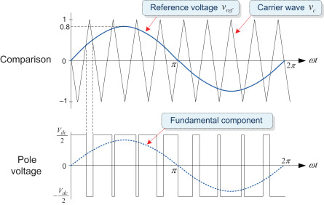
Organization of analog sinusoidal PWM
The inverter control system contains: - carrier voltage generator (most often - sawtooth); - Comparator K (null organ); - F₁ and F₂ control signal generators, VT1 and VT2 transistors, respectively.
F₁
F₂
Notes:
The classic variant of the organization of analog sinusoidal PWM is to change the width of the pulses that form the output voltage (current) by comparing the voltage of a given shape, called the reference or reference, with the sawtooth voltage, which usually has a higher frequency and is called the carrier signal. The reference signal is modulating and determines the required shape of the output voltage (current). In AC electric drives, this signal has a sinusoidal shape and the frequency of the first (basic) harmonic. Классическим вариантом организации аналоговой синусоидальной ШИМ является изменение ширины импульсов, формирующих выходное напряжение (ток) посредством сравнения напряжения заданной формы, называемого опорным или эталонным, с напряжением пилообразной формы, имеющим, как правило, более высокую частоту и называемом несущим сигналом.
Опорный сигнал является модулирующим и определяющим требуемую форму выходного напряжения (тока). В электроприводах переменного тока этот сигнал имеет синусоидальную форму и частоту первой (основной) гармоники.

Slide 29
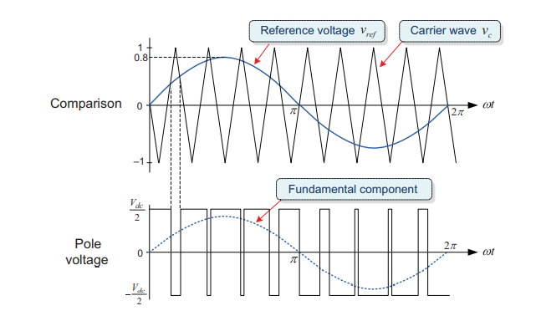
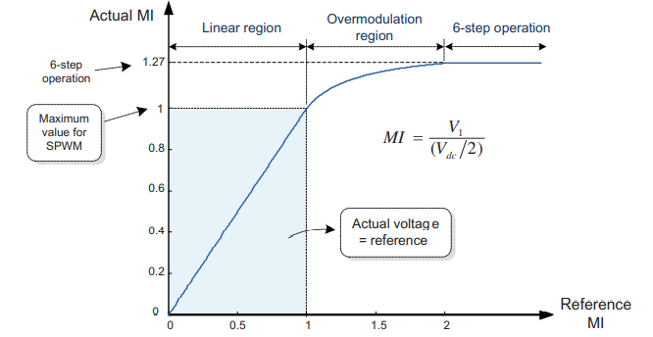
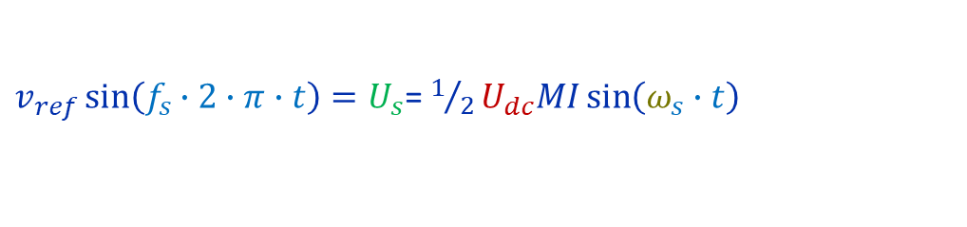

Pulse Width Control at Base Frequency
Modulation index: $MI=\frac{U_{s_{peak}}}{1/2U_{dc}}$
$U_{s}$ - AC induction motor stator phase voltage (RMS) [V]
$E_{s}$ - AC induction motor stator phase voltage back-EMF (RMS) [V]
$Ф_{s}$ - magnetic flux [Wb]
$f_{s}$ - stator phase voltage frequency [Hz]
$w_{s}$ - stator winding number
$λ$ - overload capacity
$T_{e_{st}}$ - starting torque [N*m]
$T_{e_{rated}}$ - rated torque of the machine [N*m]
$ω_{rated}$ - rated angular velocity of the machine [rad/s]
$n_{rated}$ - rated rotating velocity of the machine [rpm]
$z_{p}$ - pole pair number
Frequency modulation index:$m_{f}={f_{sw}/f}_{s}$
$v_{ref}\sin\left(f_{s}∙2∙π∙t\right)=U_{s}$= $1/2U_{dc}MI\sin\left(ω_{s}∙t\right)$
Voltage reference v_{ref} >Triangular carrier v_{c}: upper switch is turned on (pole voltage = V_{dc}/2)
Voltage reference v_{ref} <Triangular carrier v_{c} : lower switch is turned on (pole voltage =- V_{dc}/2)
Notes:
Difference Between Pole Voltage and Phase Voltage References An inverter output determined by comparing a voltage reference with the triangular carrier wave is the pole voltage.
Thus the voltage reference that is compared with the triangular carrier wave is considered as the pole voltage reference.
Typical SPWM technique uses a phase voltage reference as the pole voltage reference. On the other hand, different pole voltage reference can be used according to the PWM technique

Slide 30
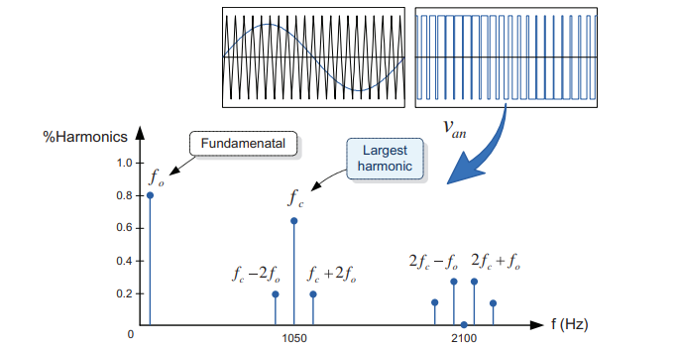
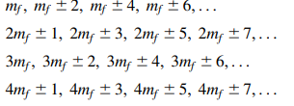

Pulse Width Control at Base Frequency
Modulation index: $MI=\frac{U_{s_{peak}}}{1/2U_{dc}}$
$U_{s}$ - AC induction motor stator phase voltage (RMS) [V]
$E_{s}$ - AC induction motor stator phase voltage back-EMF (RMS) [V]
$Ф_{s}$ - magnetic flux [Wb]
$f_{s}$ - stator phase voltage frequency [Hz]
$w_{s}$ - stator winding number
$λ$ - overload capacity
$T_{e_{st}}$ - starting torque [N*m]
$T_{e_{rated}}$ - rated torque of the machine [N*m]
$ω_{rated}$ - rated angular velocity of the machine [rad/s]
$n_{rated}$ - rated rotating velocity of the machine [rpm]
$z_{p}$ - pole pair number
Frequency modulation index:$m_{f}={f_{sw}/f}_{s}$
$$f_{0}=50Hz$$
$f_{sw}$= $f_{c}$=1050Hz
$m_{f}={f_{c}/f}_{0}$=21
Notes:
Difference Between Pole Voltage and Phase Voltage References An inverter output determined by comparing a voltage reference with the triangular carrier wave is the pole voltage. Thus the voltage reference that is compared with the triangular carrier wave is considered as the pole voltage reference. Typical SPWM technique uses a phase voltage reference as the pole voltage reference. On the other hand, different pole voltage reference can be used according to the PWM technique

Slide 31
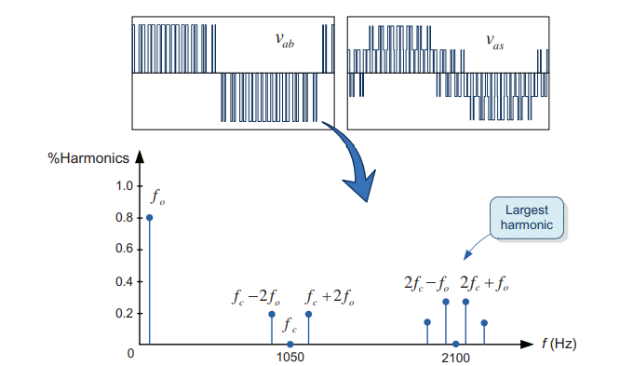
Pulse Width Control at Base Frequency
Modulation index: $MI=\frac{U_{s_{peak}}}{1/2U_{dc}}$
$U_{s}$ - AC induction motor stator phase voltage (RMS) [V]
$E_{s}$ - AC induction motor stator phase voltage back-EMF (RMS) [V]
$Ф_{s}$ - magnetic flux [Wb]
$f_{s}$ - stator phase voltage frequency [Hz]
$w_{s}$ - stator winding number
$λ$ - overload capacity
$T_{e_{st}}$ - starting torque [N*m]
$T_{e_{rated}}$ - rated torque of the machine [N*m]
$ω_{rated}$ - rated angular velocity of the machine [rad/s]
$n_{rated}$ - rated rotating velocity of the machine [rpm]
$z_{p}$ - pole pair number
Frequency modulation index:$m_{f}={f_{sw}/f}_{s}$
$$f_{0}=50Hz$$
$f_{sw}$= $f_{c}$=1050Hz
$m_{f}={f_{c}/f}_{0}$=21
Notes:
Difference Between Pole Voltage and Phase Voltage References
An inverter output determined by comparing a voltage reference with the triangular carrier wave is the pole voltage. Thus the voltage reference that is compared with the triangular carrier wave is considered as the pole voltage reference. Typical SPWM technique uses a phase voltage reference as the pole voltage reference. On the other hand, different pole voltage reference can be used according to the PWM technique

Slide 32

Regular-sampled PWM technique
Symmetrically sampling and (B) asymmetrically sampling
Notes:
The SPWM technique has been widely popular due to the simplicity of its principle and analog implementation. In the analogue implementation of the SPWM (referred to as naturally sampled PWM), an analog integrator is used to generate a triangular carrier wave, and an analog comparator is used to determine the intersection instants of the triangular carrier wave and modulating signal. In contrast, its software-based implementation using a digital technique or microprocessor is not easy because this requires solving the transcendental equation, which defines points of intersection used to determine the switching instants. Instead, as shown in Fig. 7.34, the so-called regular-sampled PWM is used in which the sinusoidal reference is held at a constant sampled value for the carrier interval, and the sampled value is compared with the carrier wave to determine the switching instants [5]. In the regular-sampled PWM, there are two types of sampling, symmetric and asymmetric. In the symmetrical sampling of

Slide 33



THIRD HARMONIC INJECTION PWM TECHNIQUE
Notes:
The SPWM technique has been widely popular due to the simplicity of its principle and analog implementation. In the analogue implementation of the SPWM (referred to as naturally sampled PWM), an analog integrator is used to generate a triangular carrier wave, and an analog comparator is used to determine the intersection instants of the triangular carrier wave and modulating signal. In contrast, its software-based implementation using a digital technique or microprocessor is not easy because this requires solving the transcendental equation, which defines points of intersection used to determine the switching instants. Instead, as shown in Fig. 7.34, the so-called regular-sampled PWM is used in which the sinusoidal reference is held at a constant sampled value for the carrier interval, and the sampled value is compared with the carrier wave to determine the switching instants [5]. In the regular-sampled PWM, there are two types of sampling, symmetric and asymmetric. In the symmetrical sampling of
Формирование выходного напряжения АИН с использованием ШИМ, уводит спектр гармоник отличных от основной в область высоких частот. Чем выше несущая частота, тем больше частота гармоник, подлежащих либо фильтрации с помощью фильтров, либо поступающих непосредственно на обмотки электромашины и выделяющихся там.
Известно, что верхний предел величины несущей частоты АИН ограничен частотными свойствами транзисторов и диодов и коммутационными потерями, уменьшающими КПД преобразователя, а также введением мертвого времени и разумной величиной периода коммутации с точки зрения сохранения необходимого диапазона регулирования выходного напряжения инвертора.
Проблему увеличения КПД и возможность реализации высокоэффективного АИН на значительные мощности с низкими частотами основной гармоники (например: тяговый электропривод) можно частично решить, используя методы выборочного исключения нежелательных гармоник, по существу путем повышения коэффициента режекции гармоник и увеличения номера первой низшей из высших гармоник в ряду Фурье.
Другими словами, кривая выходного напряжения строится таким образом, чтобы в ней отсутствовали наиболее близкие гармоники к основной. Исключение даже двух ближайших к основной гармоник, например 3-ей и 5-ой, существенно облегчает ситуацию либо с габаритами фильтра, либо с потерями в машине.
Исключение определенных гармоник может осуществляться следующими способами:
- использование дополнительных коммутаций на полупериоде выходного напряжения инвертора (рис. );
- построение кривой выходного напряжения в виде набора ограниченного числа однополярных импульсов одинаковой длительности на полупериоде выходного напряжения (рис. ).
Как видно из рис. в кривой выходного напряжения однофазного инвертора имеются "вырезки" при углах $∝_{1}$ и $α_{2}$.
На отрицательном полупериоде выходного напряжения АИН сделаны аналогичные вырезки. Такая кривая не содержит четных гармоник, а в случае трехфазного инвертора и гармоник, еще и кратных трем. Количество "вырезок" на половине периода кривой выходного напряжения соответствует количеству устраняемых гармоник.
При этом необходимо отметить, что наличие таких "вырезок" в кривой выходного напряжения естественно снижает уровень действующего значения первой гармоники этого напряжения и чем большее число нежелательных гармоник устраняется и чем больше "вырезок ", тем меньше амплитуда основной.

Slide 34
Space-vector modulation (SVM)

Slide 35

Space-vector PWM
the switched-on state of the keys is considered as 1,
the state of the inverter is described by a three-bit binary code, where the high, middle and low digit correspond to the state of the half-bridges of phases a, b and c.
For example, in the diagram fig. (a) [110] will mean a open state of the switches S1, S3 и S6 and closed S2, S4 и S3.
[001] will already mean the open state of the switches S2, S4 и S5 and closed S1, S3 и S6.
Notes:
Для исключения токов нулевой последовательности питание АД обычно осуществляется по схеме без нулевого провода. Это приводит к тому, что коммутация любого из ключей вызывает изменение напряжения на всех обмотках. Учесть эту связь можно, если представить выходное напряжение инвертора пространственным вектором в неподвижной системе координат фазных обмоток статора АД.
Состояния [000] и [111] соответствуют замыканию токов в обмотках статора верхними (нечётными) или нижними (чётными) ключами в контурах, образованных открытыми транзисторами и диодами моста, и отключению их от источника питания. При этом, прикладываемые к фазам напряжения будут равны нулю.

Slide 36


Organization of space-vector PWM
Notes:
Приведенные выше диаграммы отражают алгоритм, соответствующий включению каждого ключа на время, продолжительностью 180 эл. градусов, при котором включенному состоянию каждого из транзисторов верхней группы инвертора – VT1, VT3, VT5 соответствует выключенное состояние транзистора той же фазы нижней группы транзисторов 3-х фазного моста, т.е. VT4, VT6, VT2 и наоборот. При этом, как и при классической Sin- модуляции (скалярной) при одном открытом транзисторе верхней группы (нечетной) открыты два транзистора нижней (четной) группы трехфазного моста и наоборот.
Каждому такому состоянию транзисторов соответствует интервал π/3 или 60 град., на границах которого происходят переключения. При такой длительности интервалов имеем только шесть активных состояний ключей в мостовой схеме и шесть базовых (обобщенных) векторов в α, β –координатах и не учитываются нулевые состояния пространственного вектора.
Поэтому в плоскости α, β координат имеем соответственно шесть секторов, разграниченных векторами U1-U6, концы которых образуют правильный шестиугольник, центр которого, объединяющий начала векторов, отражает состояние YII и YIII с нулевыми значениями напряжения на фазах электромашины.
Длина вращающегося вектора U_{s} равна амплитудному значению Sin напряжения на фазах U_{а}, U_{в}, U_{с} – 2/3 U₀. Последовательный переход от одного базового вектора к последующему соответствует ступенчатой форме фазных напряжений, т.е. пространственный вектор U_{s,} в этом случае, вращается скачками с интервалом π/3, и с частотой основной гармоники выходного напряжения ω_{М} в системе неподвижных α, β координат.

Slide 37



Organization of space-vector PWM
Notes:
При модуляции пространственного вектора моменты переключения транзисторов стоек моста или коммутационные функции (S_{а},S_{в},S_{с}) определяются путем вычисления и формированием команд на переключение ключей с несущей частотой коммутации f _{н} в контроллере системы управления.
Другими словами, метод модуляции пространственного вектора состоит в усреднении его значений в пределах K-сектора с учетом относительной продолжительности его нахождения в состояниях 2-х смежных векторов U_{k} и U_{k+1} а также, с учетом относительных продолжительностей одновременного включения всех ключей верхней и/или нижней группы транзисторов моста – состояния YII или YIII с нулевыми значениями напряжения на обмотках двигателя.
Таким образом, при ПВМ для формирования ПВ необходимой величины, мы используем не только линейную комбинацию исходного и следующего за ним ненулевого базового вектора, а также один или оба нулевых вектора.
По существу алгоритм управления инвертором сводится к следующему: при заданном в определенный момент времени положении ПВ (угол θ) и его модуле (величине), требуется определить сектор угла θ на плоскости α, β координат и относительные продолжительности включения комбинаций силовых ключей инвертора, соответствующих используемым базовым векторам и относительную продолжительность включения одного и/или второго нулевого вектора.
Необходимое при частотном регулировании изменение величины напряжения на обмотках двигателя в функции частоты достигается изменением относительной продолжительности включения ненулевых векторов, что, естественно, приводит к изменению продолжительности включения и нулевых векторов. При уменьшении m_{a} и соответственно среднего значения напряжения на обмотках двигателя за период ШИМ, уменьшаются относительные времена включения ненулевых и, следовательно, увеличивается относительное время включения хотя бы одного нулевого вектора. Таким образом, управление или регулирование амплитуды задающего вектора U_{s} осуществляется изменением коэффициента или индекса амплитудной модуляции m_{a}.

Slide 38



















Organization of space-vector PWM
$$U_{3}$$
$$U_{2}$$
$$U^{∗}$$
$$U_{0},U_{7}$$
$$U_{1}$$
$$U_{4}$$
$$U_{5}$$
$$U_{6}$$
$$U_{2}$$
$$U_{2}$$
$$U_{2}$$
$$U_{2}$$
$$U^{∗}$$
$$U^{∗}$$
$$U^{∗}$$
$$U^{∗}$$
$${γ_{2}U}_{2}$$
$${γ_{1}U}_{1}$$
$$U_{1}$$
$$U_{1}$$
${γ_{0}U}_{0}$+ ${γ_{0}U}_{7}$
$$U_{1}$$
Notes:
При модуляции пространственного вектора моменты переключения транзисторов стоек моста или коммутационные функции (S_{а},S_{в},S_{с}) определяются путем вычисления и формированием команд на переключение ключей с несущей частотой коммутации f _{н} в контроллере системы управления.
Другими словами, метод модуляции пространственного вектора состоит в усреднении его значений в пределах K-сектора с учетом относительной продолжительности его нахождения в состояниях 2-х смежных векторов U_{k} и U_{k+1} а также, с учетом относительных продолжительностей одновременного включения всех ключей верхней и/или нижней группы транзисторов моста – состояния YII или YIII с нулевыми значениями напряжения на обмотках двигателя.
Таким образом, при ПВМ для формирования ПВ необходимой величины, мы используем не только линейную комбинацию исходного и следующего за ним ненулевого базового вектора, а также один или оба нулевых вектора.
По существу алгоритм управления инвертором сводится к следующему: при заданном в определенный момент времени положении ПВ (угол θ) и его модуле (величине), требуется определить сектор угла θ на плоскости α, β координат и относительные продолжительности включения комбинаций силовых ключей инвертора, соответствующих используемым базовым векторам и относительную продолжительность включения одного и/или второго нулевого вектора.
Необходимое при частотном регулировании изменение величины напряжения на обмотках двигателя в функции частоты достигается изменением относительной продолжительности включения ненулевых векторов, что, естественно, приводит к изменению продолжительности включения и нулевых векторов. При уменьшении m_{a} и соответственно среднего значения напряжения на обмотках двигателя за период ШИМ, уменьшаются относительные времена включения ненулевых и, следовательно, увеличивается относительное время включения хотя бы одного нулевого вектора. Таким образом, управление или регулирование амплитуды задающего вектора U_{s} осуществляется изменением коэффициента или индекса амплитудной модуляции m_{a}.

Slide 39

Space – Vector Modulation
Notes:
Несимметричные алгоритмы характеризуются различным состоянием транзисторов в начале и в конце периода модуляции T_{н}. Например (рис. ….., I.1, а)) на первом полупериоде последовательность переключения транзисторов моста в начале периода YII-I, а в конце периода коммутации II-YIII. При этом рис….. б) характеризует уже положение вектора U_{S} ближе к U₂ (t₂ превышает время t₁), в отличии от предыдущего рисунка, когда время t₁ превышает время t₂ и вектор U_{S} ближе к U₁ . Несимметричный алгоритм можно реализовать и с противоположным порядком YIII-II и I-YII (рис. ….., I.2, а)). Очевидно, что эти алгоритмы являются идентичными.
Можно предложить и второй несимметричный алгоритм (рис. ., II.1) , когда будет использоваться только один нулевой вектор. Тогда последовательность состояния ключей на каждом периоде модуляции T_{н} будет следующей: I-II-YII-I-II или I-II-YIII-I-II. В этом случае одна из коммутационных функций ( ) сохраняет постоянное значение. В результате в пределах каждого сектора коммутируют только две стойки моста и количество переключений за период модуляции уменьшается с шести до четырёх. Пропорционально уменьшаются и коммутационные потери в ключах. Исключение из коммутаций одного из нулевых векторов уменьшает коммутационные потери в инверторе на 33% без изменения эффективности модуляции.
Рассмотрим метод с симметричными нулевыми состояниями U₇ и U₈ на интервалах периода модуляции T_{н} (рис. ….., III). Учитывая, что обычно в течение каждого полупериода частоты модуляции T_{н}/2 состояние ключей при таком алгоритме переключения изменяется одинаково, но в обратной последовательности, для второго сектора в первой половине периода модуляции T_{н} будет следующая последовательность состояния ключей – YII(t₇/2) -I-II-YIII, а для второй половины этого же периода – YIII-II-I-YII(t₇/2), при этом t₇ = t₈.
Существует еще один метод с симметричным алгоритмом, при котором на каждом периоде модуляции T_{н} используется только одно состояние U₇ или U₈ , например, для рассмотренных выше полупериодов, последовательность состояния ключей будет – I-II-YIII, а для второй половины этого же периода – YIII-II-I, при этом длительность t₈ будет увеличена вдвое на одном полупериоде по отношению к рассмотренному выше симметричному алгоритму. Симметричные алгоритмы III и IV отличаются друг от друга только использованием нулевых векторов.

Slide 40

Space – Vector Modulation
All possible algorithms for switching the racks of a 3-phase inverter are possible divide into symmetrical and asymmetrical.
Asymmetric algorithms are characterized by different transistor states at the beginning and end of the modulation period Tn.
Time diagrams of the PVM when forming the resulting at (a) asymmetrical modulation
Notes:
Несимметричные алгоритмы характеризуются различным состоянием транзисторов в начале и в конце периода модуляции T_{н}. Например (рис. ….., I.1, а)) на первом полупериоде последовательность переключения транзисторов моста в начале периода YII-I, а в конце периода коммутации II-YIII. При этом рис….. б) характеризует уже положение вектора U_{S} ближе к U₂ (t₂ превышает время t₁), в отличии от предыдущего рисунка, когда время t₁ превышает время t₂ и вектор U_{S} ближе к U₁ . Несимметричный алгоритм можно реализовать и с противоположным порядком YIII-II и I-YII (рис. ….., I.2, а)). Очевидно, что эти алгоритмы являются идентичными.
Можно предложить и второй несимметричный алгоритм (рис. ., II.1) , когда будет использоваться только один нулевой вектор. Тогда последовательность состояния ключей на каждом периоде модуляции T_{н} будет следующей: I-II-YII-I-II или I-II-YIII-I-II. В этом случае одна из коммутационных функций ( ) сохраняет постоянное значение. В результате в пределах каждого сектора коммутируют только две стойки моста и количество переключений за период модуляции уменьшается с шести до четырёх. Пропорционально уменьшаются и коммутационные потери в ключах. Исключение из коммутаций одного из нулевых векторов уменьшает коммутационные потери в инверторе на 33% без изменения эффективности модуляции.

Slide 41
Space – Vector Modulation
Symmetric algorithms are characterized by the same state of the inverter transistors at the beginning and end of the modulation period Tn.
Time diagrams of the PVM when forming the resulting at (a) symmetrical modulation
Notes:
Рассмотрим метод с симметричными нулевыми состояниями U₇ и U₈ на интервалах периода модуляции T_{н} (рис. ….., III). Учитывая, что обычно в течение каждого полупериода частоты модуляции T_{н}/2 состояние ключей при таком алгоритме переключения изменяется одинаково, но в обратной последовательности, для второго сектора в первой половине периода модуляции T_{н} будет следующая последовательность состояния ключей – YII(t₇/2) -I-II-YIII, а для второй половины этого же периода – YIII-II-I-YII(t₇/2), при этом t₇ = t₈. Существует еще один метод с симметричным алгоритмом, при котором на каждом периоде модуляции T_{н} используется только одно состояние U₇ или U₈ , например, для рассмотренных выше полупериодов, последовательность состояния ключей будет – I-II-YIII, а для второй половины этого же периода – YIII-II-I, при этом длительность t₈ будет увеличена вдвое на одном полупериоде по отношению к рассмотренному выше симметричному алгоритму. Симметричные алгоритмы III и IV отличаются друг от друга только использованием нулевых векторов.

Slide 42
Prospects and features of the use of multi-level voltage inverters

Slide 43


THREE-LEVEL INVERTER WITH FIXING DIODES
Notes:
На этом слайде представлена схема трёхуровневого трёхфазного инвертора напряжения, нашедшего наибольшее распространение в системах электропривода, о причинах чего скажем ниже, и серийно изготавливаемая ведущими фирмами – производителями такого оборудования.
Здесь каждое плечо классического трёхфазного инвертора состоит из двух последовательно включённых полностью управляемых вентилей, шунтированных обратными диодами. Дополнительные диоды соединяют нулевую точку источника входного напряжения со средними точками плеч инвертора, образованные последовательно соединёнными вентилями.
С помощью различных комбинаций ключей можно реализовать три варианта схемы замещения инвертора, аналогичные изображённым на этом же слайде.
На основании схем замещения для данного преобразователя можно выделить четыре ненулевых ступени в кривой фазного напряжения (U_{вх}/6, U_{вх}/3, U_{вх}/2, 2U_{вх}/3). При этом, как видно из представленных на слайде эквивалентных схем подключения обмоток двигателя к источнику питания для реализации уровней 2/3 и ½. используется источник питания целиком, а для двух других уровней достаточно использования любой из двух половин.
Таким образом, трёхуровневый инвертор, имея в три раза большее (восемнадцать) число возможных положений обобщённого вектора напряжения, чем одноуровневый инвертор, позволяет более качественно сформировать кривую напряжения на нагрузке за счёт использования ещё и амплитудной модуляции обобщённого вектора напряжения.

Slide 44
PWM in a three-level inverter

Slide 45




PWM in a three-level inverter
$$\frac{U_{0}}{2}$$
B
$$0$$
A
$$−\frac{U_{0}}{2}$$
C

Slide 46



PWM in a three-level inverter
$$\frac{U_{0}}{3}$$
A
B
$$0$$
$$−\frac{{2U}_{0}}{3}$$
C

Slide 47
PWM in a three-level inverter
$$\frac{U_{0}}{2}$$
A
$$0$$
B
$$−\frac{U_{0}}{2}$$
C

Slide 48



PWM in a three-level inverter
$$\frac{{2U}_{0}}{3}$$
A
$$0$$
$$−\frac{U_{0}}{3}$$
B
C

Slide 49



PWM in a three-level inverter
$$\frac{U_{0}}{2}$$
A
$$0$$
C
$$−\frac{U_{0}}{2}$$
B

Slide 50



PWM in a three-level inverter
$$\frac{U_{0}}{3}$$
A
C
$$0$$
$$−\frac{{2U}_{0}}{3}$$
B

Slide 51
PWM in a three-level inverter
$$\frac{U_{0}}{2}$$
C
$$0$$
A
$$−\frac{U_{0}}{2}$$
B

Slide 52
PWM in a three-level inverter
$$\frac{{2U}_{0}}{3}$$
C
$$0$$
$$−\frac{U_{0}}{3}$$
A
B

Slide 53
PWM in a three-level inverter
$$\frac{U_{0}}{2}$$
C
$$0$$
B
$$−\frac{U_{0}}{2}$$
A

Slide 54
PWM in a three-level inverter
$$\frac{U_{0}}{3}$$
B
C
$$0$$
$$−\frac{{2U}_{0}}{3}$$
A

Slide 55
PWM in a three-level inverter
$$\frac{U_{0}}{2}$$
B
$$0$$
C
$$−\frac{U_{0}}{2}$$
A

Slide 56
PWM in a three-level inverter
$$\frac{{2U}_{0}}{3}$$
B
$$0$$
$$−\frac{U_{0}}{3}$$
A
C

Slide 57



Inverter circuit based on single-phase H-bridge circuits
Circuit of 3-phase voltage converter 2L-H-Bridge
Sinusoidal PWM for 5L Inverter
Notes:
At the values of the modulation index corresponding to the transition of the vector from one modulation zone to another, there is a sharp change in the ripples of the stator current vector, which, in turn, is due to a change in the switching algorithm of power switches. Obviously, the minimum level of ripple corresponds to the algorithm that forms a curve in the form of a lower envelope of the region of possible values. In the future, only this curve should be considered as a characteristic of the PWM when comparing control algorithms.
При значениях индекса модуляции, соответствующих переходу вектора из одной зоны модуляции в другую, происходит резкое изменение пульсаций вектора тока статора, что, в свою очередь, обусловлено изменением алгоритма коммутации силовых ключей. Очевидно, что минимальный уровень пульсаций соответствует алгоритму, формирующему кривую в виде нижней огибающей области возможных значений.
В дальнейшем только данная кривая будет рассматриваться в качестве характеристики ПВМ при сравнении алгоритмов управления.

Slide 58


TOPOLOGY OF MULTI-LEVEL INVERTERS
Comparison of the output voltage quality of inverters at different numbers of levels
THD=24,6%
THD=4,6%
3-level
11-level
THD=1,9%
THD=1,1%
21-level
31-level
THD=0,3%
81-level
Notes:
Multi-level inverters are becoming more and more attractive for high-voltage and high-efficiency applications. The voltage at the output of such converters has a multi-stage shape, as a result of which the harmonic coefficient is reduced compared to a conventional two-level circuit. In addition, the effective switching frequency of multi-level inverters is a function of the number of voltage levels. In other words, in order to achieve the same harmonic composition (harmonic ratio), multi-level inverters can operate at a lower switching frequency. Obviously, the theoretical performance of multi-level inverters grows with an increase in the number of levels, and, consequently, the number of switching equipment. However, in reality, the number of levels is limited by the complexity of control algorithms, the complexity of the system structure, the cost of equipment and growing heat losses.
Многоуровневые инверторы становятся всё более привлекательны для высоковольтных и высокоэффективных применений. Напряжение на выходе таких преобразователей имеет многоступенчатую форму, вследствие чего снижается коэффициент гармоник по сравнению с обычной двухуровневой схемой. Кроме того, эффективная частота коммутации многоуровневых инверторов является функцией числа уровней напряжения. Другими словами, для того, чтобы достичь того же гармонического состава (коэффициента гармоник), многоуровневые инверторы могут работать на более низкой частоте коммутации. Очевидно, что теоретический перевес многоуровневых инверторов растёт с увеличением числа уровней, а, следовательно, и количества коммутационного оборудования. Однако же, в реальности число уровней ограничено сложностью алгоритмов управления, усложнением структуры системы, стоимостью оборудования и растущими тепловыми потерями.

Slide 59


Question 1
https://forms.yandex.com/cloud/644ece1590fa7b2731c79518/
https://clck.ru/34ZTTZ

Slide 60

Question 2
https://forms.yandex.com/cloud/644ece1590fa7b2731c79518/
https://clck.ru/34ZTTZ

